Slide 1
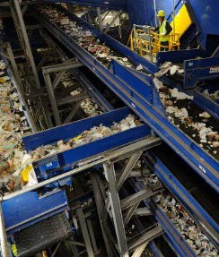
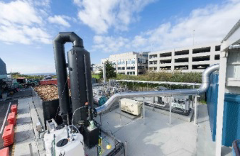
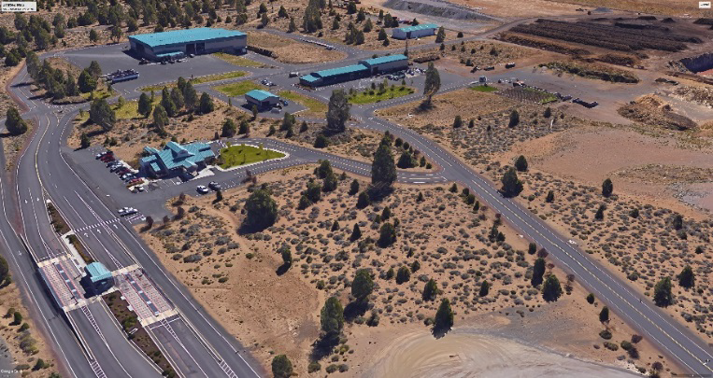
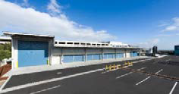

Slide 2
SWAC – Agenda 1/22/19
1. Introduction / Approval of Minutes
2. Review of Actions - Changes to Landfill Evaluation Matrix
3. Presentation Chapter 8 - Administration and Financial Management
Existing Conditions
Needs and Opportunities
Management Approaches – SWMP Implementation
Financial Impacts and Funding Options
4. Draft Executive Summary
5. Overview and Agenda for Public Meeting - January 31
6. Next Meeting – February 26, 2019

Slide 3
Chapter 7 – Landfill Disposal Options
Table 7-6: Evaluation of Disposal Options
Primary Factors | Transport Out of County | New In-County Landfill
1. Implementation Considerations | Regional landfills are permitted and have available capacity County transfer stations will need to be modified to accommodate long haul transportation | Siting a new landfill has proven to be both environmentally and politically difficult and unpredictable for communities
2. Sound Financial Principles | Proximity of several regional landfills provides competition that can result in lower fees Impacts to local economy as revenue and jobs are created in other jurisdictions | County and cities control rates Revenue and jobs stay in County
3. Cost Effectiveness | Estimated cost to transport and dispose varies $47-$60/Ton | Estimated costs $35 disposal + $ 7 transport $42/ton (Assumes landfill is 25 miles or less from Knott Transfer Station) Note: After initial debt is retired 2040, the operating cost will be reduced by about $4/ton

Slide 4
Chapter 7 – Landfill Disposal Options
4. Rate Stability | Disposal contracts can be written to provide certainty of cost Factors outside control of County could impact fees (Host fees, fuel prices, road mile taxes etc.) | Based on history of tip fees at Knott Landfill, disposal costs are predictable and stable
5. System Flexibility | Flexibility can be part of contract; may have impacts on tip fee If minimum waste supply is committed, there may be possible impacts to County or cities to implement alternatives | County controls waste and disposal system and can make changes as needed (Example if local jurisdictions implement new diversion programs) County retains ability to manage waste without contractual issues
6. Reliability | Disposal is reliable Transporting waste to regional landfills may encounter interruptions In general, regional landfills have good track record for environmental compliance | Transportation and disposal are reliable Transporting waste on certain roads may encounter short term interruptions County has control and can manage environmental risks County can control nature of waste is disposed in the landfill

Slide 5
Chapter 7 – Landfill Disposal Options
7. Environmental Considerations
7.1 Impact from Landfilling: Greenhouse gas (GHG) emissions | No waste would be disposed in Deschutes County, but emissions would impact other jurisdictions | Emission impacts will remain in Deschutes County
7.2 Impact from Transportation: Waste Disposed 2030 – 216,000 tons/year 6,800–7,000 trips/year 2040 – 250,000 tons/year 7,800–9,000 trips/year | In 2030, 2-2.1 million truck miles and emissions along local roads and highways 97 and 197 In 2040, 2.3–2.7 million truck miles and emissions along highways 97 and 197 | In 2030, 340,000 -350,000 truck miles and emissions along local roads and highways In 2040, 390,000-450,000 truck miles and emissions along local roads and highways
7.3 Impact on Land | Existing regional landfills are permitted and will continue to fill designated sites with or without Deschutes County waste | County will need to disturb 400-500 acres* County may adopt mitigating measures as necessary *Note: Existing quarry sites might provide opportunity to restore disturbed land

Slide 6
Chapter 8 – Administration and Financial Management
Chapter 8 - Purpose:
Review Current Administration / Financial Resources
Examine Needs to maintain and execute to Recommendations of the SWMP
Evaluate Options to Make Necessary Changes
Make Recommendations to Modify/ Enhance System

Slide 7
Chapter 8 – Administration and Financial Management
Existing Solid Waste System Management
County - Department of Solid Waste (DSW):
Owns / Operates Transfer Stations and Knott Landfill
System Structure:
County Operates Facilities Contract Services
County / Cities Interlocal Agreements
County/ Cities Franchise Collection Services

Slide 8
Chapter 8 – Administration and Financial Management
County Mission Statement
“Provide environmentally sound and cost-effective solid waste management services that are in compliance with all laws and regulations to the citizens of Deschutes County”

Slide 9
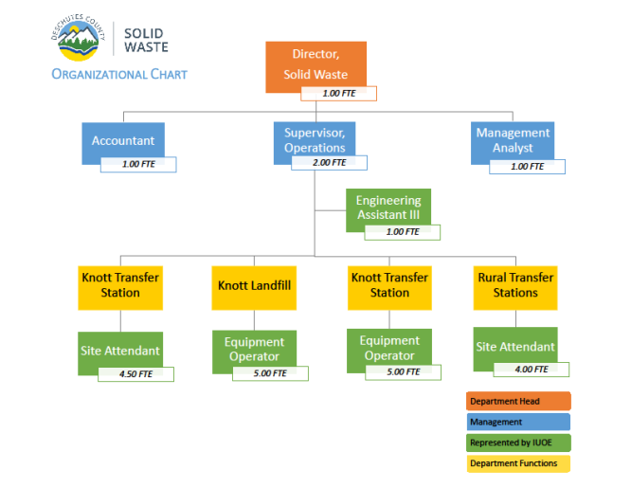
Chapter 8 – Administration and Financial Management

Slide 10
Chapter 8 – Administration and Financial Management
Solid Waste Enforcement:
ODEQ – Permits / Regulate facilities
Illegal Dumping – County’s Community Development Department’s Code Enforcement Division

Slide 11
Chapter 8 – Administration and Financial Management
Findings:
County provides resources to operate and manage facilities that are compliant with regulations
Organization is in place to carry-out services
County/Cities/Franchise collection companies offer programs and
services that meet state WR/R standards
Participants has established coordinated promotion /education
w/ Environmental Center

Slide 12
Chapter 8 – Administration and Financial Management
Financial Management (DSW):
Operates and Enterprise Fund (Public Utility)
Annually Reviews Revenue Requirements and Budgets
Financial System Considers Annual Expenditure
Established Reserves to Maintain Rate Stability

Slide 13
Chapter 8 – Administration and Financial Management
Actual and Projected Expenditures – FY 2016 – FY2019
Revenue Requirements (Expenditures) | FY 2016 Actual | FY 2017 Actual | FY 2018 Budget | FY 2019 Adopted
Personal Services | $1,967,190 | $2,049,320 | $2,278,466 | $2,504,623
Materials & Services | $3,483,735 | $4,334,705 | $4,859,217 | $4,772,159
Debt Service and Bond Refinance | $6,219,266 | $ 858,512 | $ 861,102 | $ 860,938
Capital Outlay | $ 74,313 | $ 127,449 | $ 125,000 | $ 173,000
Transfers Out | $1,726,539 | $3,075,000 | $2,580,000 | $4,688,023
Contingency | - | - | $ 569,886 | $600,000
Total Requirements | $13,471,043 | $10,444,985 | $11,273,671 | $13,598,743

Slide 14
Chapter 8 – Administration and Financial Management
Allocation of Expenditures to Operations
Service | Cost Allocation
Disposal of Solid Waste – Knott Landfill | 60%
Operation of Transfer Stations (4) | 26%
Recycling Marketing/ Transportation/ Special Waste (HHW) / Mulching | 5%
Debt Service | 9%

Slide 15
Chapter 8 – Administration and Financial Management
Funds | FY 19 Fund Balance
Landfill Closure Fund – Established to make final improvements required to close the landfill once it is completed. | $4,037,938
Landfill Post Closure Fund – Established to collect funds dedicated for monitoring and maintaining the landfill after it closes. | $1,057,948
Capital Projects Fund – Funds set aside to make improvements and expansions to existing facilities or to build new facilities. | $3,104,840
Equipment Fund – Funds needed to purchase large equipment needed for operations. | $543,175
Total Reserve Funds | $8,743,901

Slide 16
Chapter 8 – Administration and Financial Management
Actual and Projected Revenues – FY16 – FY19
Revenue Sources | FY 2016 Actual | FY 2017 Actual | FY 2018 Budget | FY 2019 Adopted
Beginning Net Working Capital | $1,163,893 | $1,810,265 | $ 615,872 | $1,730,130
Charges for Services | $8,755,712 | $9,780,396 | $10,614,998 | $11,795,572
Interest Revenue | $ 24,335 | $ 31,959 | $ 20,000 | $ 44,000
Other Non-Operational Revenue | $ 10,801 | $ 12,801 | $ 10,801 | $ 11,041
Sale of Assets, Land or Equipment | $ 40,673 | $ 47,242 | $ 12,000 | $ 18,000
Re-finance Bonds – Capital Issuance of Long-Term Liability | $5,285,895 | - | - | -
Total Resources | $15,281,308 | $11,682,663 | $11,273,671 | $13,598,743

Slide 17
Chapter 8 – Administration and Financial Management
Findings:
Current Management system operates effectively
County/ Cities / Franchise collection – deliver cost effective services
DSW has developed transfer system to provide convenient services
DSW has operated Knott Landfill in full compliance and financially sound
Effectively Use Internal Resources in Conjunction with Private Contractors
DSW has managed as Solid Waste Enterprise > 25 Years

Slide 18
Chapter 8 – Administration and Financial Management
Needs and Opportunities:
SWMP provides roadmap for enhancing services, making capital investments in infrastructure and addressing long term disposal of waste
Changes to collection programs /services
Expand residential food waste collection
Development multi-family programs
Expand recycling for businesses – food waste/ recyclables
Establish uniform / standardization for programs and services
Develop Alternative for construction/ demolition (C/D)waste
Changes / Improvements for facilities
Evaluate options / upgrade compost facilities
Upgrade transfer stations – capacity / efficiencies / future disposal system
Develop facilities for managing C/D waste
Implement new disposal system

Slide 19
Chapter 8 – Administration and Financial Management
Needs and Opportunities:
As new collection programs are developed – facilities must be provided to manage materials and waste cost effectively
County / cities need to work with franchise collection companies to evaluate and implement new programs; considering policies; establish rates and expand promotion/education
Process needs to engage special interest and affected parties
Solid Waste System Infrastructure requirements estimated to be between $20M and $30M - County needs to develop financial plan to implement facility improvements

Slide 20
Chapter 8 – Administration and Financial Management
Alternatives – Administration / Management
Maintain Existing Management Structure w/ Enhancement
Establish Steering Committee
Appoint Special task forces
Establish SWAC – oversee implementation of SWMP
Update Interlocal agreements

Slide 21
Chapter 8 – Administration and Financial Management
Alternatives – Administration / Management
2. Regional Management Approaches
Joint Powers Boards – Parties wish to have joint decision making authority for certain matters
- Used to establish regional financial system
- Establish joint rate setting
b.) Special District – Used frequently with multiple jurisdictions for single purpose utility
- Consolidate common operations for economic reasons - Lower rates
- Financing capital investments

Slide 22
Chapter 8 – Administration and Financial Management
Financial and Funding
County to evaluate resources needed to support implementation
Maintain County Enterprise System
Uses County Bonding authority – low cost for financing capital
Establish reserves to maintain rate stability
Rate setting / financial system is transparent
Finance w/ Bonds
Use Rates to finance Improvements (Pay–Go)

Slide 23
Chapter 8 – Administration and Financial Management
SWAC – Discussion
What changes should be made to oversee implementation of SWMP ?
How to increase participation ?
Financing / Funding – changes ?

Slide 24
Landfill Disposal Public Meeting
Purpose:
Provide an update on the Solid Waste Management Plan (SWMP)
Get feedback on two disposal options
Program
5:00 – 6:00 – Open House
Tables – Boards with Information /Evaluation Matrix
6:00 – Timm – Overview SWMP and Disposal Options
6:30 – Return to Open House – discussion and input

Slide 25
Upcoming Schedule
January 31, 2019 – Public Meeting – Disposal Options
February 26 – SWAC Meeting –
Chapter 7 - Landfill Disposal Recommendations
Chapter 8 - Management & Financial Management Recommendations
March 26 - Final Draft SWMP – Implementation Schedule
April – Final Draft SWMP to Board of Commissioners

