Slide 1


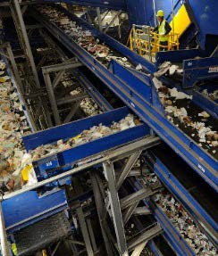
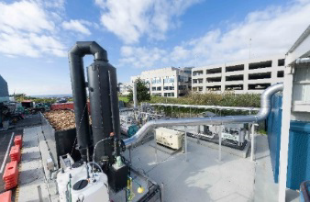
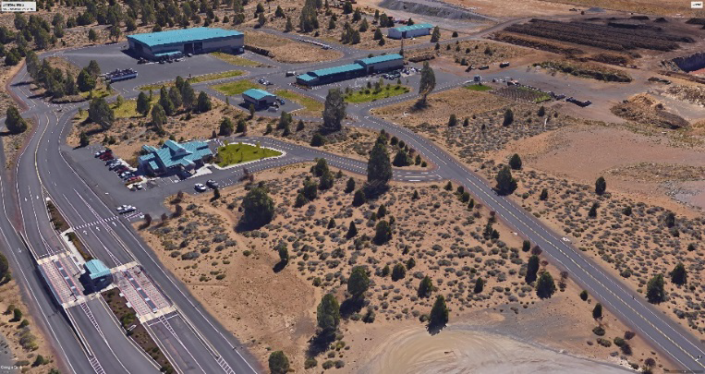
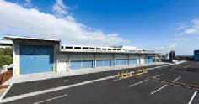





Slide 2
SWAC – Agenda 10/23/18
Chapter 6 – Alternative Technology – Draft Findings
2. Chapter 7 – Draft Landfill Disposal
      Existing Disposal System
      Disposal Options
      - Transport to Out of County Landfill
      Crook County
      - Site new In-County Landfill
      Evaluation of Options
3. Schedule of Meetings

Slide 3
Chapter 6 – Alternative Technology
Alternative Technology | Capital Cost | Approximate Tipping Fee
Organics (AD with ASP) | $45 Million $5 Million pre-processing $35 Million facility–(80,000tpy) $5 Million post-processing | $50-$70/ton
MWP/Engineered Fuel (EF) | $50 - $100 million | $60-$70/ton
MWP/Energy Recovery (Biofuels) | $250 - $300 million | $60-$70/ton
Recovery Rates
30% - 40%
30% - 50% RDF
30%

Slide 4
Chapter 6 – Alternative Technology
Findings
Alternative technology for managing waste in Deschutes County does not appear feasible at this time.
Markets for the renewable energy or fuel products are not readily available at this time.
The Knott Landfill is expected to operate 10 or 11 years. This provides the opportunity for the County to monitor conditions and to reassess the potential of implementing an alternative technology in 3 to 5 years.
4. Only consider those technologies/ vendors that have a proven record of successfully operating a commercial scale facility.

Slide 5
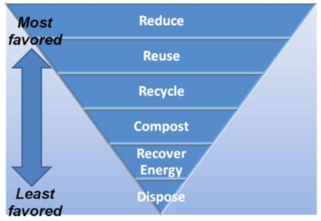
Chapter 7 – Landfill Disposal
State Hierarchy for Managing Waste
First Step
Reduce Waste and Recycle (Chapters 3 & 4)
Alternative Technologies/ Resource
Recovery
Landfill Disposal
From Oregon DEQ

Slide 6
Chapter 7 – Landfill Disposal
Existing Conditions
All waste (MSW and C/D) are disposed at Knott Landfill
Estimated Capacity / Site life – 10 -11 Yrs.
If waste reduction and recycling strategies are implemented the site life may be increased by 2 to 3 Yrs.

Slide 7
Chapter 7 – Landfill Disposal
Deschutes County Tonnage to Disposal Operations
Knott Landfill | 2014 | 2015 | 2016 | 2017 | 2018
Annual Waste Disposed | 130,615 | 144,981 | 161,081 | 181,326 | 192,000 Est.
% Change | 9.5% | 11.0% | 11.1% | 11.4% | 6.1%

Slide 8
Chapter 7 – Landfill Disposal
Knott Landfill Expenses 2016
Knott Landfill Operating Expenses | 2016 (Actual)
Operations | $ 2,662,000
Fees and Permits (DEQ) / Insurance | $ 400,000
Transfer to Funds | $ 2,500,000
Capital Reserves
Equipment Reserves
Closure and Post Closure
Contingency (7%) | $ 400,000
Total Annual Operating Expenses | $ 5,962,000

Slide 9
Chapter 7 – Landfill Disposal
Current Disposal / Ton Cost
Total Annual Operating Expenses |  | $ 6,000,000 | $/ Ton
Annual Waste Disposed | 2016 | 161,000 | $37.27
Annual Waste Disposed | 2017 | 181,000 | $33.15
Average Disposal Cost |  |  | $ 35.21

Slide 10
Chapter 7 – Landfill Disposal
Deschutes County Waste Disposal Projections (Conservative Approach)
Year | Population | Per Capita (will decline to 2,800 Lb / Cap / Yr) | Waste Generated (tons) | Waste Recycled (tons) | Recovery Rate (33%) | Waste Disposed (tons)
2015 | 170,606 | 2,663 | 227,333 | 83,381 | 36.7% | 143,952
2016 | 174,701 | 2,727 | 240,844 | 79,757 | 33.1% | 161,087
2017 | 178,893 | 3,022 | 270,326 | 89,000 | 32.9% | 181,326
2018 | 183,187 | 3,000 | 274,780 | 90,677 | 33.0% | 184,103
2019 | 187,583 | 3,000 | 281,375 | 92,854 | 33.0% | 188,521
2020 | 190,734 | 3,000 | 286,101 | 94,413 | 33.0% | 191,688
2021 | 194,739 | 3,000 | 292,109 | 96,396 | 33.0% | 195,713
2022 | 198,829 | 3,000 | 298,243 | 98,420 | 33.0% | 199,823
2023 | 203,004 | 2,900 | 294,356 | 97,138 | 33.0% | 197,219
2024 | 207,267 | 2,900 | 300,538 | 99,177 | 33.0% | 201,360
2025 | 210,826 | 2,900 | 305,698 | 100,880 | 33.0% | 204,817
2026 | 214,832 | 2,800 | 300,764 | 99,252 | 33.0% | 201,512
2027 | 218,913 | 2,800 | 306,479 | 101,138 | 33.0% | 205,341
2028 | 223,073 | 2,800 | 312,302 | 103,060 | 33.0% | 209,242
2029 | 227,311 | 2,800 | 318,236 | 105,018 | 33.0% | 213,218
2030 | 230,412 | 2,800 | 322,577 | 106,450 | 33.0% | 216,126

Slide 11
Chapter 7 – Landfill Disposal
Year | Projected Disposal Rates
2030 | 216,126
2031 | 220,020
2032 | 223,983
2033 | 228,018
2034 | 232,125
2035 | 233,597
2036 | 237,185
2037 | 240,829
2038 | 244,528
2039 | 248,285
2040 | 251,195
2041 | 254,711
2042 | 258,277
2043 | 261,893
2044 | 265,560
2045 | 268,182
2046 | 271,668
2047 | 275,200
2048 | 278,777
2049 | 282,401
Total | 4,992,561
Average | 249,628
Projected Waste Disposed
5 M Tons – 20 Yrs..
Average 250,000 TPY – 20 Yrs..

Slide 12
Chapter 7 – Landfill Disposal
Landfill Disposal Options
Transport and dispose at Out of County Site(s)
  Regional Landfill
  Crook County Landfill
Site and Construct a New In-County Landfill

Slide 13
Chapter 7 – Landfill Disposal
Transport and dispose at Out of County Site(s)
  Regional Landfill
  Crook County Landfill

Slide 14
Long-Haul Waste
Regional Landfills
Landfills Located East of Cascades
1) Columbia Ridge Landfill, Arlington, OR. – Owned & Operated by Waste Management
2) Finley Butte Landfill, Boardman, OR – Owned & Operated by Waste Connections
3) Wasco County Landfill, The Dalles, OR – Owned & Operated by Waste Connections
4) Roosevelt Regional Landfill, Roosevelt, WA - Owned & Operated by Republic Services
Landfills Located West of Cascades
5) Coffin Butte Landfill, Corvallis, OR. – Owned & Operated by Republic Services
6) Dry Creek Landfill, Medford, OR, Owned & Operated by Rogue Disposal

Slide 15
Long-Haul Waste
Crook County Landfill (CC)
The Landfill has over 100 Yrs. with current waste flows
CC will accept portion of Deschutes County
Current rates - $35 per ton + $5 Host Fee

Slide 16
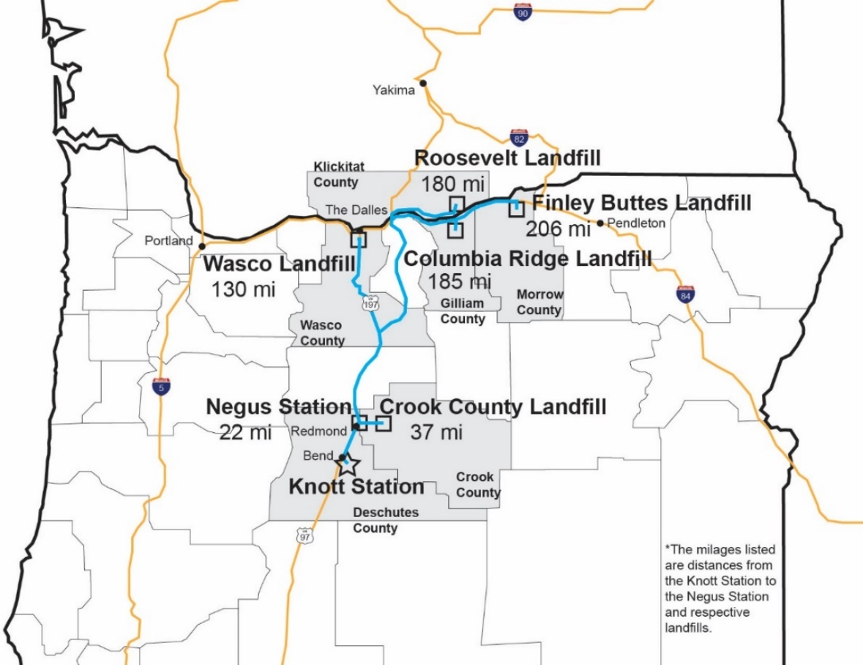
Long-Haul Waste
Location and Distances to Landfills and Transfer Stations

Slide 17
Long-Haul Waste
Knott Transfer Station
Description | Transportation Costs Rounded ($/ton) | Landfill Disposal Costs+ Host Fee ($/ton)(1) | Total Transportation/ Disposal +Host Fee ($/ton) | Transfer Station Costs ($/ton) | Total ($/ton)
Station and Wasco Landfill (135 miles one-way) | $19.00 | $28.00-$31.00 | $47.00-$50.00 | $12.00 | $59.00-$62.00
Station and Columbia Ridge Landfill (185 miles one-way) | $26.00 | $30.00-$33.00 | $56.00-$59.00 | $12.00 | $68.00-$71.00
Station and Finley Buttes Landfill (206 miles one-way) | $29.00 | $30.00-$33.00 | $59.00-$62.00 | $12.00 | $71.00-$74.00
Station and Roosevelt Landfill (180 miles one-way) | $25.00 | $30.00-$33.00 | $55.00-$58.00 | $12.00 | $67.00-$70.00
Station and Crook County Landfill (35 miles one-way) | $8.00(2) | $40.00(3) | $48.00 | $12.00 | $60.00
Negus Transfer Station
Station and Wasco Landfill (110 miles one-way) | $16.00 | $28.00-$31.00 | $44.00-$47.00 | $12.00 | $58.00-$59.00
Station and Crook County Landfill (18 miles one-way) | $6.00 (2) | $40.00 (3) | $46.00 | $12.00 | $58.00
Assumes a host fee of $6 per ton for all regional landfills. Host fees may vary by jurisdiction The cost to transport from Deschutes County transfer stations were adjusted considering time to travel through congested areas Crook County tip fee is based on the current published gate rate of $35 per ton plus a $5 per ton host fee.

Slide 18
Long-Haul Waste
Implementation and Schedule
Transfer stations modified to handle surge / temporary storage capacity (2- 4 years)
Add compactor equipment to improve cost to transport
($1.5 M for system)
3. Evaluate Transportation options
Public ownership of trailers vs private operations
4. Prepare RFP to solicit proposals and select vendor and award contract ( 2 years )

Slide 19
Site and Build a New In-County Landfill
Site New In- County Landfill
Estimate 400- 500 acres to provide 100 Yrs. capacity
  - Includes area for buffer
  - Site would be developed and closed in phases
County previously conducted site study in late 1990’s
Areas of County appear to satisfy locational standards
Site and Build
a New In-County Landfill

Slide 20
Site and Build a New In-County Landfill
Siting a New Landfill
Step 1 – Establish a Need for the New Landfill
Step 2 – Identify Potential Areas/ Sites that Meet Locational Criteria
Step 3 – Complete Siting Process and Site Characterizations Consistent w/ DEQ Permitting Requirements on the Preferred Site(s)
Step 4 – Complete Permit Documents and DEQ Application
Step 5 – Complete Permit Application Process

Slide 21
Site and Build a New In-County Landfill
Siting a New Public Landfill
Landfill Siting Process (Public Meetings) | $ 300,000
Site Characterization Reports | $ 1,000,000
Preliminary Engineering and Permit Documents | $ 1,200,000
Permitting Contingency (20%) | $ 500,000
Total | $ 3,000,000

Slide 22
Site and Build a New In-County Landfill
Landfill Development / Construction Cost
Support Facilities (Includes access roads; scales; employee center; Maintenance shops; utilities) | $ 4,000,000
Initial landfill cells / Leachate collection | $ 2,000,000
Leachate lagoon and controls | $ 1,000,000
Environmental Monitoring systems | $ 1,000,000
Subtotal | $ 8,000,000
Engineering/ Construction Services/ Administration | $ 1,200,000
Contingency (15%) | $ 1,600,000
Total Estimated Construction Cost | $ 11,000,000

Slide 23
Site and Build a New In-County Landfill
Implementation and Schedule
Complete Siting studies and permitting - 5 to 6 Yrs.
(assumes potential legal challenges)
2. County has some risk exposure for obtaining permits based on past experience in state
3. Requires capital Investment to site and build (2 -3 Yrs.)

Slide 24
Chapter 7 – Landfill Disposal

Slide 25
Chapter 7 – Landfill Disposal

Slide 26
Chapter 7 – Landfill Disposal

Slide 27
Upcoming Schedule
November 27th SWAC – Continue Discussion of Landfill Options
Public Meeting Dates
December Meeting – Chapter 8 – Administration / Financial
January Draft SWMP – Implementation Schedule

