Slide 1
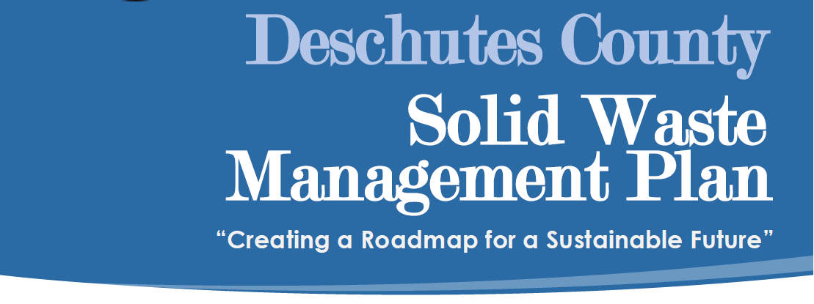

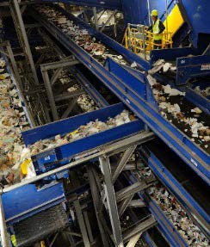
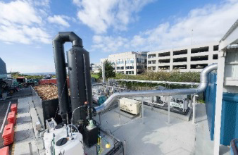
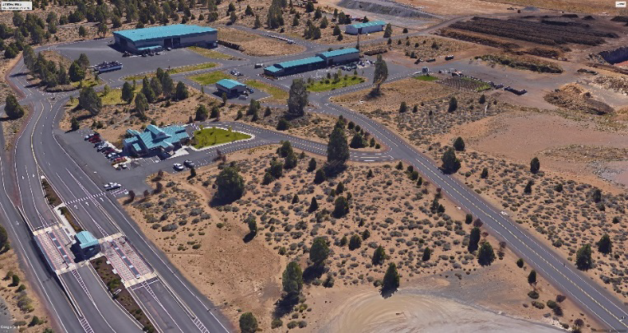
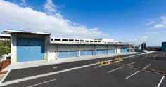
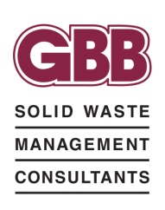




Slide 2
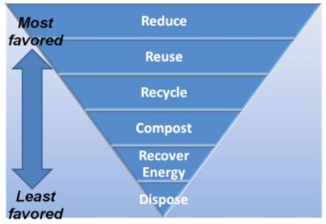
Chapter 6 – Alternative Technology and Solid Waste Disposal
State Hierarchy for Managing Waste
First Step
Reduce Waste and Recycle (Chapters 3 & 4)
Resource
Recovery / Alternative Technologies
From Oregon DEQ

Slide 3
Chapter 6 – Alternative Technology and Solid Waste Disposal
1. Background / Existing Conditions
  Existing Disposal System
  Cost of Disposal
  Waste Projections

Slide 4
Chapter 6 – Alternative Technology and Solid Waste Disposal
Deschutes County Tonnage to Disposal Operations
Knott Landfill | 2014 | 2015 | 2016 | 2017 | 2018
Annual Waste Disposed | 130,615 | 144,981 | 161,081 | 181,326 | 192,000 Est.
% Change | 9.5% | 11.0% | 11.1% | 11.4% | 6.1%

Slide 5
Chapter 6 – Alternative Technology and Solid Waste Disposal
Knott Landfill Expenses 2016
Knott Landfill Operating Expenses | 2016 (Actual)
Operations | $ 2,662,000
Fees and Permits (DEQ) / Insurance | $ 400,000
Transfer to Funds | $ 2,500,000
Capital Reserves
Equipment Reserves
Closure and Post Closure
Contingency (7%) | $ 400,000
Total Annual Operating Expenses | $ 5,962,000

Slide 6
Chapter 6 – Alternative Technology and Solid Waste Disposal
Current Disposal / Ton Cost
Total Annual Operating Expenses |  | $ 6,000,000 | $/ Ton
Annual Waste Disposed | 2016 | $ 161,000 | $37.27
Annual Waste Disposed | 2017 | $ 181,000 | $33.15
Average Disposal Cost |  |  | $ 35.21

Slide 7
Chapter 6 – Alternative Technology and Solid Waste Disposal
Deschutes County Waste Disposal Projections (Conservative Approach)
Year | Population | Per Capita (will decline to 2,800 Lb / Cap / Yr) | Waste Generated (tons) | Waste Recycled (tons) | Recovery Rate (33%) | Waste Disposed (tons)
2015 | 170,606 | 2,663 | 227,333 | 83,381 | 36.7% | 143,952
2016 | 174,701 | 2,727 | 240,844 | 79,757 | 33.1% | 161,087
2017 | 178,893 | 3,022 | 270,326 | 89,000 | 32.9% | 181,326
2018 | 183,187 | 3,000 | 274,780 | 90,677 | 33.0% | 184,103
2019 | 187,583 | 3,000 | 281,375 | 92,854 | 33.0% | 188,521
2020 | 190,734 | 3,000 | 286,101 | 94,413 | 33.0% | 191,688
2021 | 194,739 | 3,000 | 292,109 | 96,396 | 33.0% | 195,713
2022 | 198,829 | 3,000 | 298,243 | 98,420 | 33.0% | 199,823
2023 | 203,004 | 2,900 | 294,356 | 97,138 | 33.0% | 197,219
2024 | 207,267 | 2,900 | 300,538 | 99,177 | 33.0% | 201,360
2025 | 210,826 | 2,900 | 305,698 | 100,880 | 33.0% | 204,817
2026 | 214,832 | 2,800 | 300,764 | 99,252 | 33.0% | 201,512
2027 | 218,913 | 2,800 | 306,479 | 101,138 | 33.0% | 205,341
2028 | 223,073 | 2,800 | 312,302 | 103,060 | 33.0% | 209,242
2029 | 227,311 | 2,800 | 318,236 | 105,018 | 33.0% | 213,218
2030 | 230,412 | 2,800 | 322,577 | 106,450 | 33.0% | 216,126

Slide 8
Chapter 6 – Alternative Technology and Solid Waste Disposal
Year | Projected Disposal Rates
2030 | 216,126
2031 | 220,020
2032 | 223,983
2033 | 228,018
2034 | 232,125
2035 | 233,597
2036 | 237,185
2037 | 240,829
2038 | 244,528
2039 | 248,285
2040 | 251,195
2041 | 254,711
2042 | 258,277
2043 | 261,893
2044 | 265,560
2045 | 268,182
2046 | 271,668
2047 | 275,200
2048 | 278,777
2049 | 282,401
Total | 4,992,561
Average | 249,628
Projected Waste Disposed
5 M TPY – 20 Yrs.
Average 250,000 TPY – 20 Yrs.

Slide 9
Chapter 6 – Alternative Technology (AT)
What are AT’s?
Technologies designed to Convert / Extract Resources from Municipal Waste Streams
“Treat Waste as a Resource”
Advance Sustainable Materials Management

Slide 10
Chapter 6 – Alternative Technology (AT)
What are AT’s?
Definitions / Categories
Technologies to directly recover materials or energy from the waste stream including: aerobic composting; anaerobic digestion; mechanical separation and sizing; and / or thermal processing.
A conversion technology facility uses thermal, chemical, mechanical and/or biological processes to convert separated organic solid waste (a specific solid waste that contains carbon molecules, such as waste plastic or rubber) into fuels, chemicals or other useful products. (OAR)

Slide 11
Chapter 6 – Alternative Technology (AT)
Why Build AT’s?
To Recover Valuable Materials
To Produce Renewable Energy
To Reduce the Carbon Footprint of Managing Waste
To Reduce Solid Waste Management Transportation Impacts
To Create Local Economic Benefit

Slide 12
Chapter 6 – Alternative Technology (AT)
Current Technologies
Mixed Waste Processing
  Prepares waste for conversion
Construction and Demolition
  Basic Recovery
  High Tech
Engineered Fuel Production
Composting (Mixed Waste)
Anaerobic Digestion (AD)
Mass Burn
Mechanical Biological Treatment (MBT)
Pyrolysis / Gasification
Gasification for Electricity Production
MSW to Biofuels

Slide 13
Chapter 6 – Alternative Technology
Technologies Not Economically Feasible
Mass Burn for Electricity Production
Gasification for Electricity Production

Slide 14
Chapter 6 – Alternative Technology
Technologies - May Be Feasible
These Technologies All Require Pre-processing / MRF
C/D Processing (Discussed in Chapter 4)
AD with ASP Composting
MBT – ALT Solid Fuel Production
MSW to Bio Fuels

Slide 15
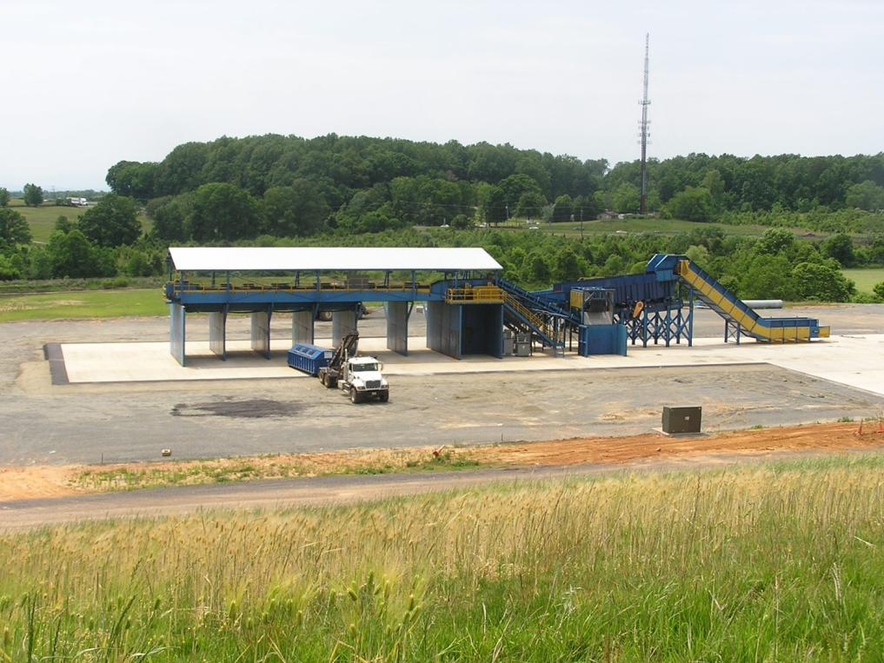
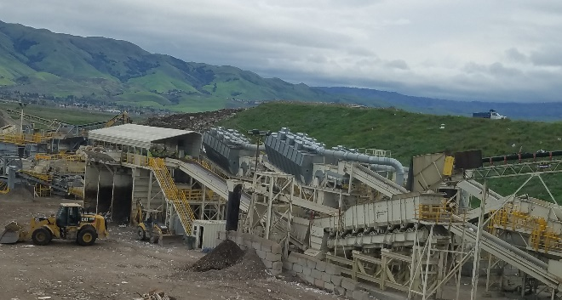
Chapter 6 – Alternative Technology
C&D Processing
Basic: Fauquier County, VA
Hi Tech: Zanker, San Jose CA

Slide 16
Chapter 6 – Alternative Technology
C&D Processing
Chapter 4: Collection and Processing
Estimated 30% or approximately 50,000 tpy is C&D wastes.
Basic Recovery system requires low capital investment and can be relatively quickly constructed.
Domestic markets for recovered materials, less China impact
Recommended as a targeted material in Chapter 4.

Slide 17
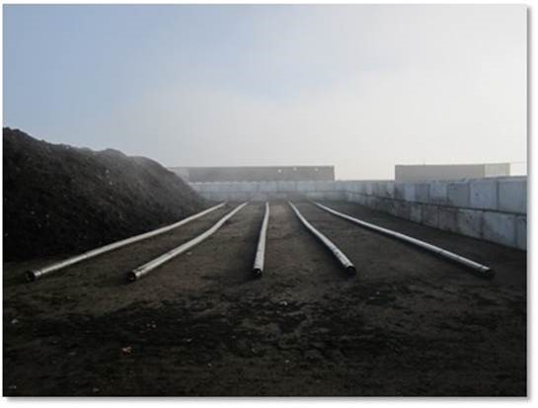
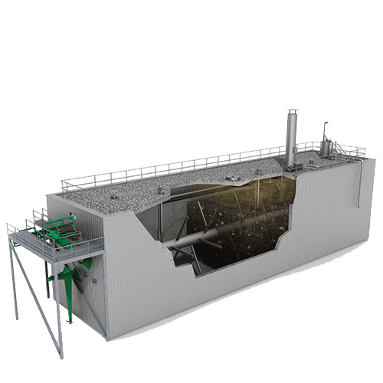
Chapter 6 – Alternative Technology
Anaerobic Digestion (AD) w/ Aerated Stack Pile (ASP) Composting
Aeration Pipes for Aerated Static Pile (ASP) Composting
Plug Flow System with Mixing Shafts

Slide 18
Chapter 6 – Alternative Technology
Current Status of AD Systems
Provider | Processes | Facilities
Quasar Energy Group | Wet Anaerobic Digestion | 14 operational plants across the U.S.
Zero Waste Energy | Dry Anaerobic Digestion | Monterey, San Jose, South San Francisco in CA
CR&R- Eisenmann | Dry Anaerobic Digestion | Perris, California
General Electric | Wet Anaerobic Digestion | Acquired Monsal technology with operating facilities in Europe
BioFerm | Wet and Dry AD | 5 plants in North America
Organic Waste Systems | Dry Anaerobic Digestion | 30 operating plants in Europe and Asia
Thoni | Dry Anaerobic Digestion | Plants in Europe licensed to Martin GmbH
Hitachi Zosen Kompogas | Dry Anaerobic Digestion | 75 facilities worldwide

Slide 19
Chapter 6 – Alternative Technology
Anaerobic Digestion (AD) with Composting
Requires source separation of clean organic wastes (food, yard, etc.,).
Removes materials from the landfill which can decompose quickly into methane before landfill gas capture systems are fully installed, reduces GHG impacts.
AD element produces renewable natural gas.
Composting element produces a valuable soil amendment.

Slide 20
Chapter 6 – Alternative Technology
Mechanical Biological Treatment (MBT) - ALT Solid Fuel Production
“Making Fuel Source Out of MSW”

Slide 21
Chapter 6 – Alternative Technology
MBT / Alternative Solid Fuel
Commonly practiced in Europe.
Front end processing plant:
      Recovers additional recyclables
      Removes wet organics
About 50% of the inbound MSW converting into high quality solid fuel for use as a coal substitute.
Displacing coal with biogenic MSW derived solid fuel reduces GHG emission

Slide 22
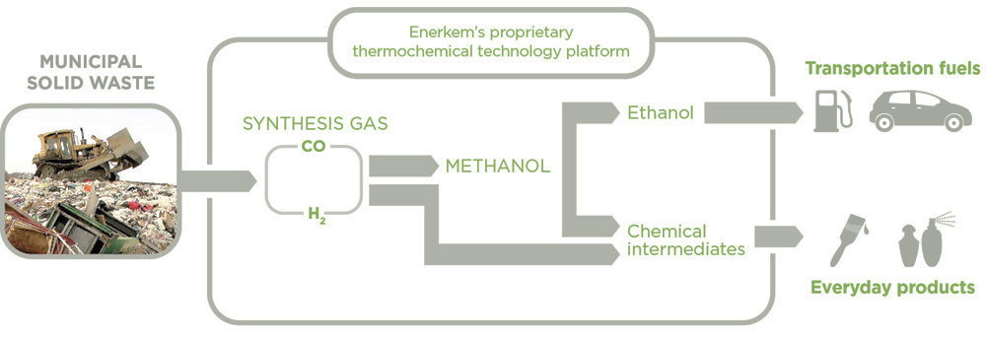
Chapter 6 – Alternative Technology
MSW to Bio Fuels
FORESTRY WASTE

Slide 23
Chapter 6 – Alternative Technology
MSW / Forestry Biomass to Bio Fuels
Produce renewable transportation fuel (cellulosic ethanol) from MSW and forestry biomass waste.
Deschutes County is too small for an MSW only facility, but combined waste streams could be a competitive option.
Project could represent $400 million in private sector investment creating hundreds of facility and forestry sector jobs.

Slide 24
Chapter 6 – Alternative Technology
AT Summary
Alternative Technology | Capital Cost | Approximate Tipping Fee
Organics (AD with ASP) | $45 Million | $50-$70/ton
MWP/Engineered Fuel (EF) | $50 - $100 million | $60-$70/ton
MWP/Energy Recovery (Biofuels) | $250 - $300 million | $60-$70/ton
Cost include: Preprocessing/ MRF
Revenue from sale of recyclable and energy products
Disposal of residue

Slide 25
Chapter 6 – Alternative Technology
Conclusions
1. Certain technologies that process / convert MSW to energy sources are commercially viable
2. Depending on local market conditions these technologies may be feasible
- Price of energy ; renewable energy tax credits i.e. California; Canada
- Local demand or uses for CNG;LNG
- Cost to transport and dispose of MSW
3. Demand for AT is growing and anticipate the cost effectiveness will improve
4. All technologies will produce a residue or not accept certain waste that will need to be disposed in a landfill

