Slide 1
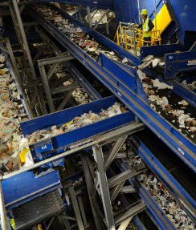
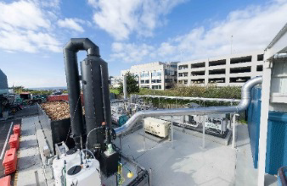
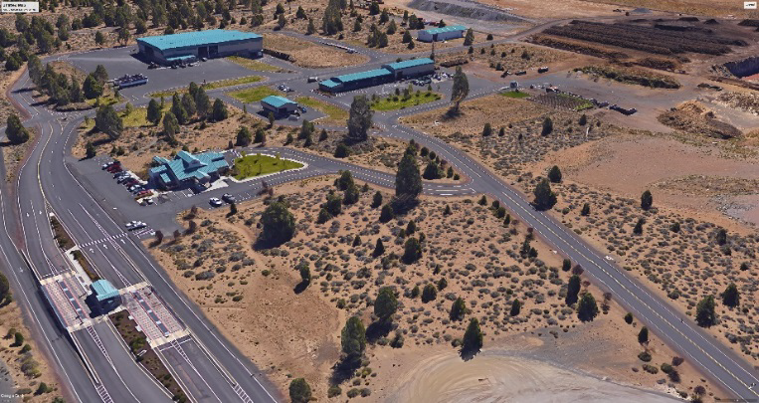
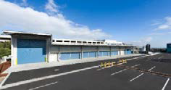

Slide 2
Today: March 27, 2018
Chapter 3: Waste Prevention, Reduction, Reuse, and Recycling
Analysis tables
Chapter 4: Collection and Recycling/Processing
Background and Trends
Flow Diagram – What happens to all of the waste in Deschutes County?
Needs and Opportunities
Yard Waste/Food Waste
C&D
Multifamily
Facilities: Organics, Material Recovery Facilities, Mixed Waste Processing
Processing Options
MRF - Integrated Commingled + Mixed Waste
Compost of Organics
Anaerobic Digesters (AD)

Slide 3
Chapter 3 – Waste Prevention, Reduction, Reuse, and Recycling Analysis
Waste Prevention, Reduction, Reuse, and Recycling Alternatives Analysis
 |  |  | Analysis
Need/Alternative Identified | Key Point | Expansion Program/New Program | Consistent with hierarchy | Reduces long-term generation | Highest and best use | Cost effective and stabilizes rates long-term | Flexibility | Examples
Standardize Waste Prevention, Reduction, Reuse and Recycling Messaging/Communications | Budget $3.00/HH/year This is new. | Expansion/New | Yes | Contributes to effective communication | Yes- aimed at WR/R | Current programs work- more resources needed | Programs are adaptable | Marion County
Reduce Waste Generation | Consider options most desirable to goals | Expansion/New | Yes | Yes | Yes | Not effective without enforcement | Varies | California
1) Material bans (plastic bags; yard waste/food waste) | Political desire must be there | New | Yes | Yes | Yes | Difficult to measure impact | No | Seattle; Massachusetts; others
2) Grasscycling/backyard composting | Good communication point | New | Yes | Yes | Yes | Requires ongoing training program | Yes | Portland Metro
3) Residential messaging for opt-out programs | Residents appreciate | Expansion | Yes | Yes | Yes | Small impact | Yes | Montgomery County, MD
4) Food waste apps to increase diversion of usable food | Great for residents and businesses | New | Yes | Yes | Yes | Can be effective | Yes | New England
Stimulate reuse | Build from Goodwill programs now | Expansion | Yes | Extends useful life of products | Yes | Saves system cost | Yes | Fauquier County, VA
Notes:
Analysis Recap
To provide an integrated solid waste management system that addresses an effective combination of strategies and programs guided by the hierarchy adopted by the state to first, reduce waste at the source; second, to reuse and recycle materials; third, to compost; fourth, to recover energy, and last, to dispose of waste in landfills.
To continue educating consumers to promote practices and methods to reduce the long-term per capita waste generation rate and seek, through community outreach, a cooperative approach to assume individual responsibility to reduce waste.
To develop programs and support implementation of system improvements that seek to ensure materials recovered from the waste stream attain the highest and best use and are recycled.
To develop a solid waste system that is based on sound financial principles, provides cost effective services and maintains rate stability over a long term, while allocating costs equitably to all users.
To maintain system flexibility to respond to changes in waste stream composition, waste management technologies, public preferences, new laws and changing circumstances.

Slide 4
Chapter 3 – Waste Prevention, Reduction, Reuse, and Recycling Analysis CON’T
Waste Prevention, Reduction, Reuse, and Recycling Alternatives Analysis CON’T
 |  | Analysis
Need/Alternative Identified | Key Point | Expansion Program/New Program | Consistent with hierarchy | Reduces long-term generation | Highest and best use | Cost effective and stabilizes rates long-term | Flexibility | Examples
Outreach and events diversion | Support event and venue diversion | Expansion/New | Yes | Yes | Yes | Requires committee resources | Yes | Kent County, MI
Continue Waste Reduction/Recycling Grants | Allow for individual and group projects | Expansion | Yes | Yes | Yes | NA | Yes | North Carolina; Oakland, CA
Encourage hotels and tourist centers to focus on Waste Prevention, Reduction, Reuse and Recycling | Ties into commercial/multifamily program | New | Yes | Yes | Yes | Yes | Yes | Vail, CO; Whistler, BC; Park City, UT; Big Sky, MT
Expand Commercial/Multifamily Recycling and Food Waste Recovery | Large opp for diversion; add staff, increase partner funding allocation, & explore University partnership | Expansion/New | Yes | Yes | Yes | Requires persistent promotion/education, rate incentive | Yes | Seattle; Portland Metro
Residential Yard Waste/Food waste | Make service consistent across County | Expansion | Yes | Yes | Yes | Increase subscribers to pay, reduces waste to long-hauled | Yes | Minneapolis, MN
Promote Increased Diversion of Electronic Devices from the Waste Stream | Increase awareness of collection points; utilize Waste Wizard or other application | Expansion | Yes | Yes | Yes | Yes | Yes | Tampa and Hillsborough County, FL
Notes:
Analysis Recap
To provide an integrated solid waste management system that addresses an effective combination of strategies and programs guided by the hierarchy adopted by the state to first, reduce waste at the source; second, to reuse and recycle materials; third, to compost; fourth, to recover energy, and last, to dispose of waste in landfills.
To continue educating consumers to promote practices and methods to reduce the long-term per capita waste generation rate and seek, through community outreach, a cooperative approach to assume individual responsibility to reduce waste.
To develop programs and support implementation of system improvements that seek to ensure materials recovered from the waste stream attain the highest and best use and are recycled.
To develop a solid waste system that is based on sound financial principles, provides cost effective services and maintains rate stability over a long term, while allocating costs equitably to all users.
To maintain system flexibility to respond to changes in waste stream composition, waste management technologies, public preferences, new laws and changing circumstances.

Slide 5
Chapter 4 – Collection and
Recycling/Processing
What actions should Deschutes County and stakeholders/partners take regarding solid waste?
Reduce Waste Disposed in landfills
Recycle more materials to maximize recovery of resources
Achieve the County’s goals
Implement programs and build facilities to maintain cost effective system
Chapter 4 explores:
Are there ways to expand or create new programs to have generators separate at the source and provide collection services for those customers?
What infrastructure is needed to support those services?

Slide 6
Chapter 4 Collection and Recycling Processing Deschutes County Waste Stream 2016
Waste Composition | % of Total Waste | Total Waste (Disposed+ Recyclables) (tons) | Waste Disposed (tons) | % Disposed | Recycled Materials (tons)
Total Paper | 26% | 62,198 | 40,272 | 25% | 21,926
Cardboard/ Kraft | 8% | 18,185 | 5,638 | 4% | 12,547
Clean Mixed Paper/ ONP | 7% | 15,822 | 6,443 | 4% | 9,379
Mixed Paper | 5% | 11,276 | 11,276 | 7% | -
Compostable / Soiled | 7% | 16,109 | 16,109 | 10% | -
Total Plastics | 6% | 14,327 | 12,887 | 8% | 1,440
Organics | 43% | 102,654 | 67,657 | 42% | 34,997
Yard Debris | 14% | 33,266 | 6,443 | 4% | 26,823
Wood | 9% | 22,330 | 16,109 | 10% | 6,221
Food | 18% | 42,701 | 41,883 | 26% | 818
Other Organics | 2% | 4,357 | 3,222 | 2% | 1,135
Glass | 4% | 9,786 | 3,222 | 2% | 6,564
Metal | 8% | 19,844 | 11,276 | 7% | 8,568
Aluminum | 1% | 2,230 | 1,611 | 1% | 619
Tin Cans | 1% | 3,549 | 3,222 | 2% | 327
Other (Scrap Metal) | 6% | 14,065 | 6,443 | 4% | 7,622
Other Inorganics | 9% | 21,584 | 19,330 | 12% | 2,254
Rock/ Concrete/ Brick | 3% | 6,033 | 4,833 | 3% | 1,200
Gypsum Wallboard | 2% | 4,833 | 4,833 | 3% | -
Electronics | 1% | 2,663 | 1,611 | 1% | 1,052
Misc. Organics | 5% | 11,278 | 11,276 | 7% | 2
Other Materials | 4% | 10,055 | 6,443 | 4% | 3,612
Motor Oil | 1% | 2,245 | 322 | 0.20% | 1,923
Other Materials | 3% | 6,522 | 4,833 | 3% | 1,689
Other Recyclables | 0% | 396 | - | 0% | 396
Total Waste | 100% | 240,844 | 161,087 | 100% | 79,757
Commodities
(41,077 tpy)
Source Separation
MRF
Organics (48,326 tpy)
Yard Waste
Food Waste
Other (32,218 tpy)
Wood
Compostable Paper
Total - 121,621 tpy
Goal Recover – 33%
- 40,000 tpy

Slide 7
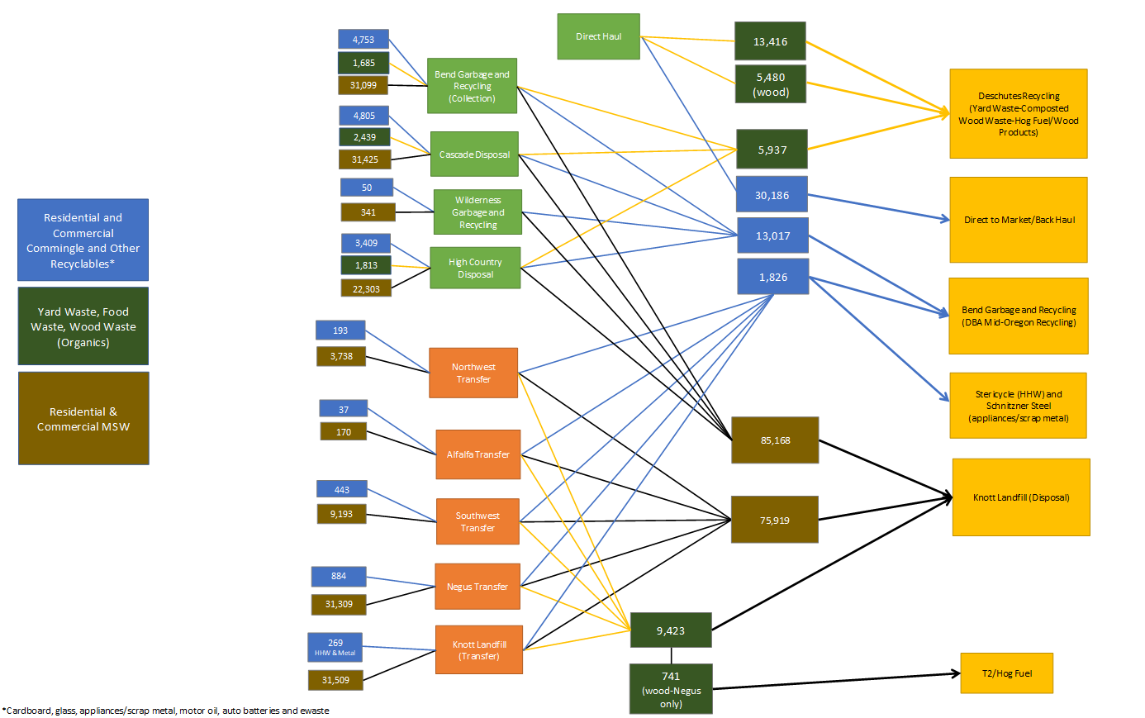
Chapter 4 – The Flow of Waste Through Deschutes County DRAFT
Notes:
The Flow Diagram presents the current flow of waste in Deschutes County from the franchised haulers collection, direct haul, transfer and processing.
For the Flow Diagram - the overall sum of MSW collected and hauled to the Knot Landfill by franchised haulers (85,168 tons) was calculated by subtracting the amount of MSW sent by transfer stations to the landfill (75,919) from the total amount received in 2016 (161,081). The tons of MSW collected by each hauler was estimated by extrapolating the percentage of recyclables collected by hauler and applying that breakdown to the 85,168 aggregate tons that are hauled to the landfill.

Slide 8
Needs and Opportunities for Collection and Recycling/Processing
Processing Alternatives for Recycling Services
Build a Materials Recovery Facility (MRF) for Residential Commingled Recyclable Materials
Build a Materials Recovery Facility for Residential Commingled Recyclable Materials and Mixed Commercial Waste
Enhance Processing facilities to handle Food Waste
Anaerobic Digestion option
Upgrade Deschutes Recycling Compost Facility
Process and utilize all within Deschutes County
Completely independent of market, insulated from geopolitical risk (i.e. National Sword)

Slide 9
Needs and Opportunities for Collection and Recycling/Processing (2)
2. Target Specific Generators or Waste Streams by Expanding Basic Services
Cardboard and Scrap Metal in commercial waste stream and multifamily
Expand Residential Curbside Services
Expand commingled recycling service to rural areas.
Collection of yard waste, food waste and glass are not offered consistently.
Increase Multifamily Housing Recycling Program
Multifamily complexes need space to store commingled materials generated by each unit
Standard design guidelines can help
Educational/Promotional programs
Many complexes offer garbage service as part of the rent – Incentives needed!

Slide 10
Needs and Opportunities for Collection and Recycling/Processing (3)
3. Target New Materials
Divert “Dry Commercial Waste” to Bend Garbage & Recycling MRF
Require commercial businesses to separate recyclables from MSW
EX: Clothing stores dispose of hangers (plastic, metal, wood) in abundance → uniform materials (low contamination) and high volumes!
Food Waste
24% of the overall waste stream – 43,000 tons disposed in Knott Landfill
Expand Residential and Commercial Food Waste Recycling Program(s)
Textile Recycling
The Secondary Materials and Recycled Textiles (SMART) → SMART maintains a searchable database by product category and state for textile collection programs
Construction & Demolition Debris
30% of material disposed at Knott landfill = C&D
High volumetric density means it is difficult to compact, occupies important space in Knott
Highly recyclable + Knott Landfill was not designed for C&D
Notes:
Fauquier County, VA has textile recycling program accompanied by a “Second Generation” reuse site at their Corral Farms drop off location. Textiles instructions are to “bring clean & dry clothes, drapes, blankets, paired shoes, belts purses, towels, sheets, etc. Items can be ripped or stained.”
Seventeen years ago, Fauquier County became one of the first municipalities in the US with a wide-scale municipal textile recycling program. In its first three years, approximately 125 tons of post-consumer textile waste (PCTW) per year were collected, generating more than $115,000 in revenue at market prices. From an industry report at that time, it was noted that PCTW was one of Fauquier County’s highest recyclable revenue generators and resulted in a 10% decrease in overall recycling costs.

Slide 11
Deschutes County SWMP - Recycling Options
Expand Collection Services
a. Residential Food and yard waste collection – materials taken to compost
b. Expand commercial food waste
c. Collect more commingled or source separated materials from multi – family
and commercial customers
Build MRF facilities
a. Process both commingled materials and mixed waste from commercial generators
3. Enhance / Expand Organics Processing

Slide 12
Chapter 4 Collection and Recycling Processing Deschutes County Waste Stream 2016
Waste Composition | % of Total Waste | Total Waste (Disposed+ Recyclables) (tons) | Waste Disposed (tons) | % Disposed | Recycled Materials (tons)
Total Paper | 26% | 62,198 | 40,272 | 25% | 21,926
Cardboard/ Kraft | 8% | 18,185 | 5,638 | 4% | 12,547
Clean Mixed Paper/ ONP | 7% | 15,822 | 6,443 | 4% | 9,379
Mixed Paper | 5% | 11,276 | 11,276 | 7% | -
Compostable / Soiled | 7% | 16,109 | 16,109 | 10% | -
Total Plastics | 6% | 14,327 | 12,887 | 8% | 1,440
Organics | 43% | 102,654 | 67,657 | 42% | 34,997
Yard Debris | 14% | 33,266 | 6,443 | 4% | 26,823
Wood | 9% | 22,330 | 16,109 | 10% | 6,221
Food | 18% | 42,701 | 41,883 | 26% | 818
Other Organics | 2% | 4,357 | 3,222 | 2% | 1,135
Glass | 4% | 9,786 | 3,222 | 2% | 6,564
Metal | 8% | 19,844 | 11,276 | 7% | 8,568
Aluminum | 1% | 2,230 | 1,611 | 1% | 619
Tin Cans | 1% | 3,549 | 3,222 | 2% | 327
Other (Scrap Metal) | 6% | 14,065 | 6,443 | 4% | 7,622
Other Inorganics | 9% | 21,584 | 19,330 | 12% | 2,254
Rock/ Concrete/ Brick | 3% | 6,033 | 4,833 | 3% | 1,200
Gypsum Wallboard | 2% | 4,833 | 4,833 | 3% | -
Electronics | 1% | 2,663 | 1,611 | 1% | 1,052
Misc. Organics | 5% | 11,278 | 11,276 | 7% | 2
Other Materials | 4% | 10,055 | 6,443 | 4% | 3,612
Motor Oil | 1% | 2,245 | 322 | 0.20% | 1,923
Other Materials | 3% | 6,522 | 4,833 | 3% | 1,689
Other Recyclables | 0% | 396 | - | 0% | 396
Total Waste | 100% | 240,844 | 161,087 | 100% | 79,757
Commodities
(41,077 tpy)
Source Separation
MRF
Organics (48,326 tpy)
Yard Waste
Food Waste
Other (32,218 tpy)
Wood
Compostable Paper
Total - 121,621 tpy
Goal Recover – 33%
- 40,000 tpy

Slide 13
Chapter 4 – MRF Processing (Example)
Waste/ Materials to be Processed (2016)
1. Residential Commingled 13,000 TPY
2. MSW (Collected) 120,000 TPY
Estimated Commercial 60,000 TPY
Total Processed 73,000 TPY
Estimated Recovered Materials (TPY)
1. Commingled 13,000 (90%) 11,700
2. Commercial MSW 60,000 (20%) 12,000
Estimated Total 23,700
3. Mixed Organics Output Estimate 15,000 - 20,000 TPY
Total Potential Recovered Materials 38,700 – 43,700 (53%- 60%)
Amount Landfilled 34,300 – 29,300 tpy

Slide 14
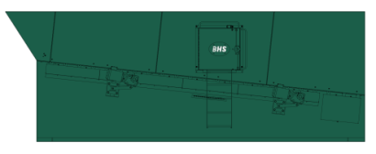
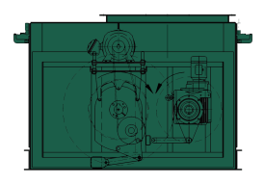
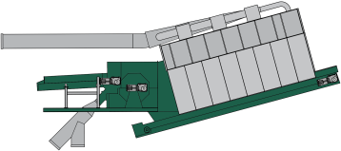
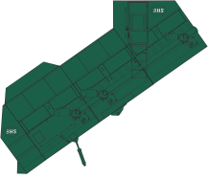
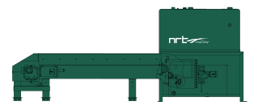
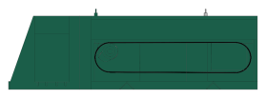
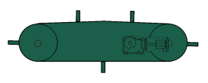
Mixed Waste Processing
Modern Mixed-waste Processing
Screening
Bag Openers
Air Density Separators
Ballistic Separators
Optical Sorting
Eddy Current
Magnetic Separation

Slide 15
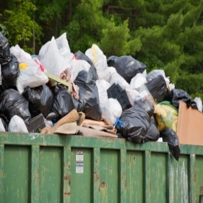
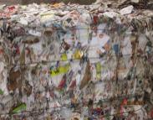
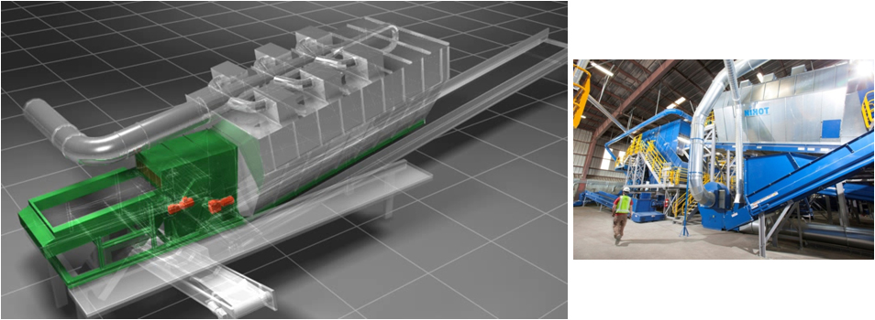
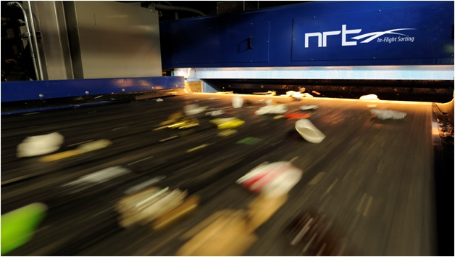
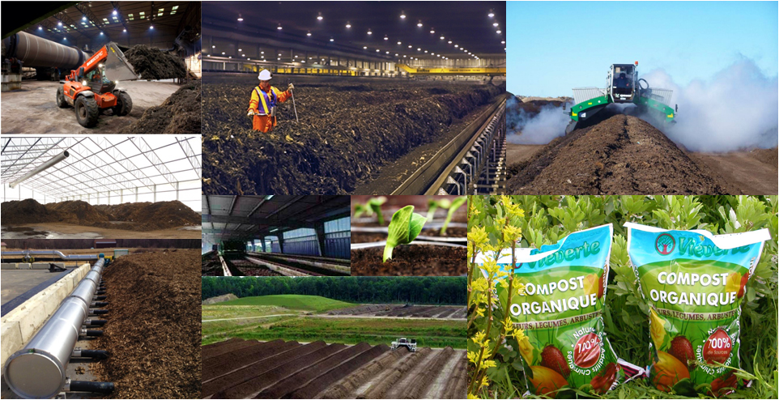
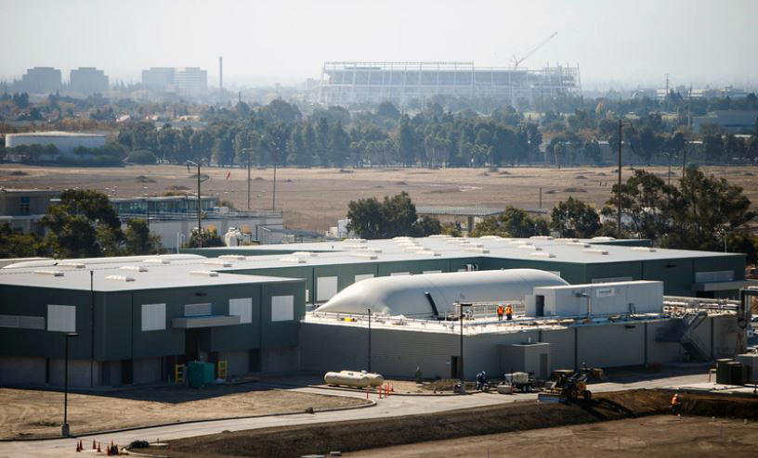
Mixed Waste MRF Tech
Front End - Separate Organics Early
1 or 2 Stages
Typical SS Equipment
Bag Breaker
Initial
Screening
2nd Screen & Density Separator
2 Stage Fiber/
Container Screens
Fiber Rich Material
Sorting
Line
8”-12”
Fines
(Organics)
-2”
Optical Sorters
-
Magnet
-
Eddy Current
Containers
(Plastics/Cans/
Aluminum )
Quality Control Sorters
Magnet
2”8”
To
AD and/or Compost

Slide 16
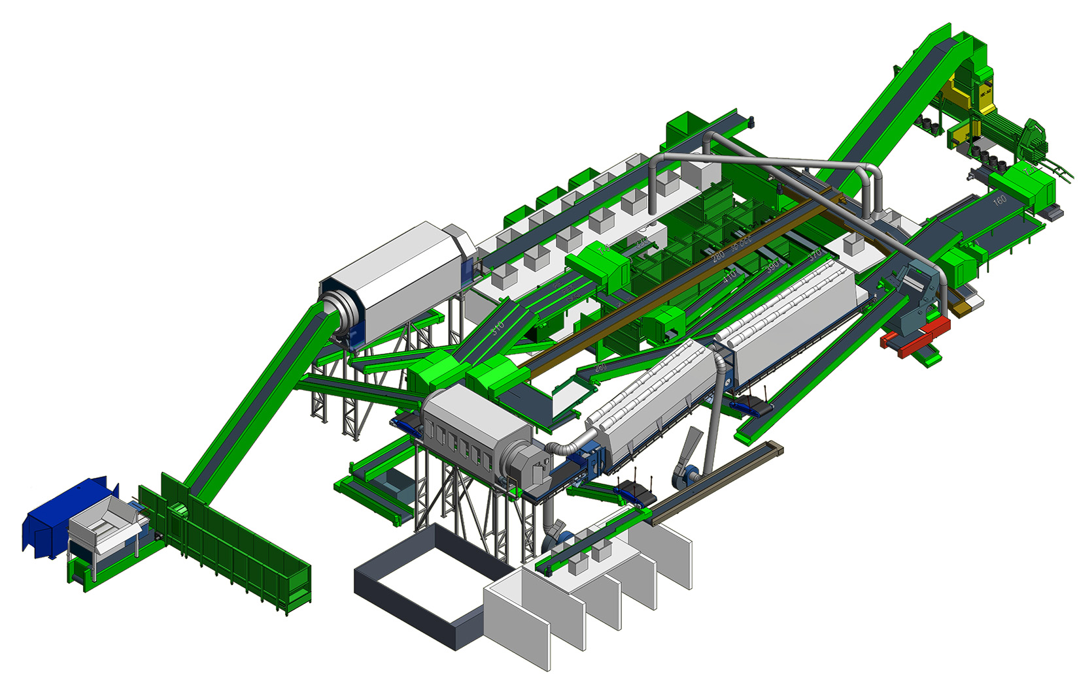
Mixed Waste MRF Tech
Advanced MRF Processing System
Capital and Installation Cost - $12 M to $15 M

Slide 17
What Are the Costs?
Construction Cost of MRF (70,000 TPY MRF or 270 TYD)
*SAMPLE PROJECT
MRF Building
80,000 sf @ $300/sf w/o Land $24,000,000
Annual Debt Service 5% @ 20 yrs $ 1,925,000/yr
MRF Equipment – 30-35 TPH
Mixed Waste MRF - 15yrs @ 5%
- Low $12,000,000 $ 1,150,000/yr
- High $15,000,000 $ 1,400,000/yr
Annual Debt Service $ 3,075,000 to $3,325,000

Slide 18
What’s It Worth?
Material Processed Recovered Recycled
MSW + Commingled 73,000
All Paper 29,900 50% 15,000 TPY
Plastics 16,900 20% 3,500 TPY
Metal 6,500 80% 5,200 TPY
Total Recovered Commodities 23,700 TPY
Average $/Ton $50 - $120 /Ton Approx. $1,200,000 - $ 2,800,000
Transportation Cost to Markets @ $ 25 /ton ($600,000)
Net Revenue to System $ 600,000 - $ 2,200,000
Cost To Operate (Est) $ 4,000,000 - $ 5,000,000 (Excludes Capital)
Net Cost to Operate $ 2,800,000 - $ 3,400,000
Capital (Debt Service) $ 3,200,000
Cost to Operate (73,000 tpy) $ 6,000,000 – $ 6,600,000 ~ $80 - $90 /ton
What will be future avoided cost when Knott Landfill closes?

Slide 19
Organics to Compost

Slide 20
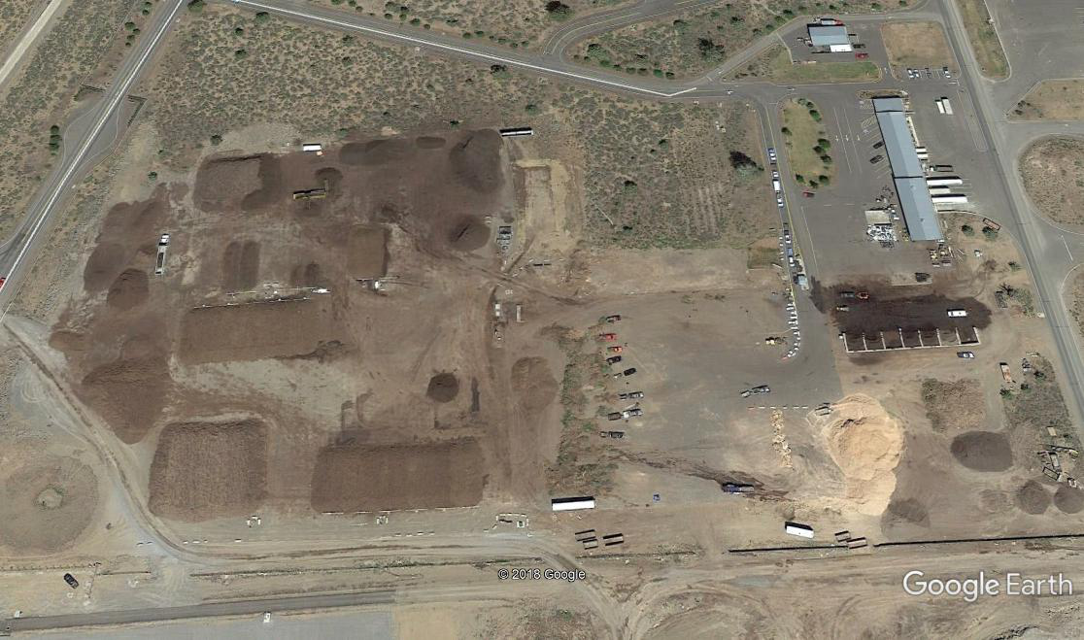
Compost Processing Options
Deschutes Compost Site – 18 Acres
Existing Materials 2016
Yard Debris 27,000 TPY
Food Waste 1,000 TPY
Wood Waste 6,200 TPY
Total 29,200 TPY

Slide 21
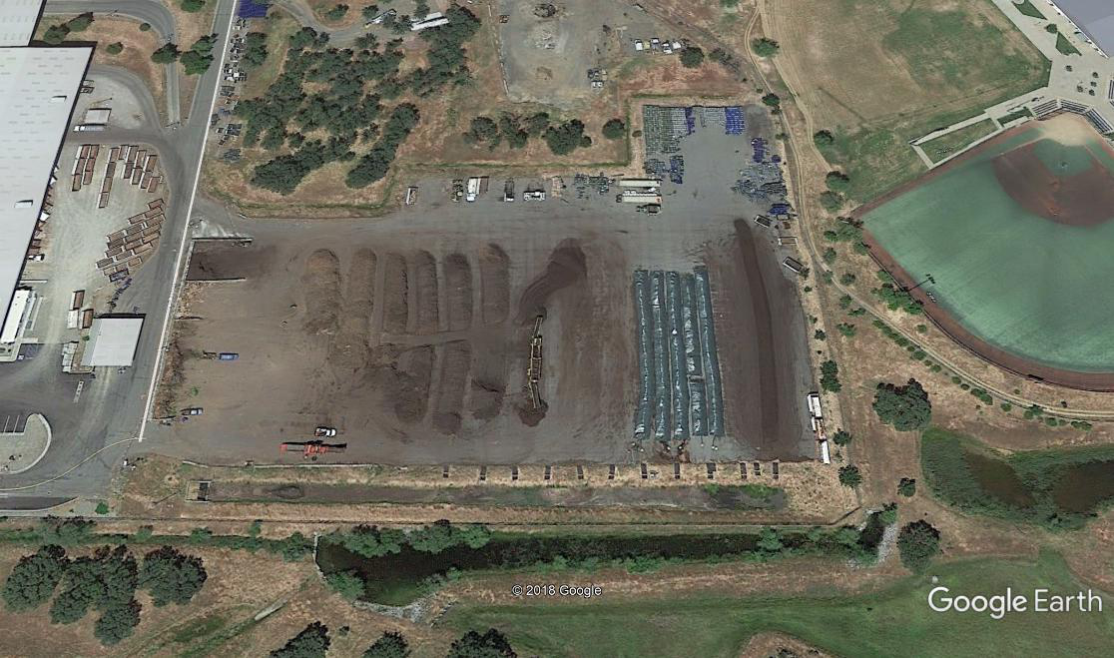
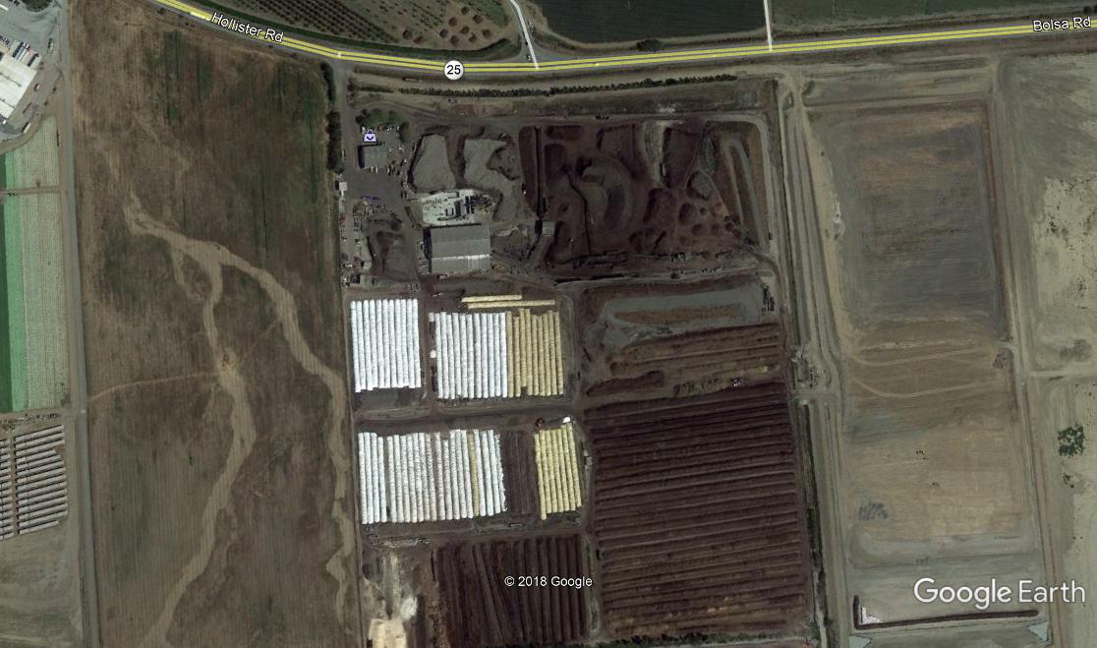
Compost Options Ag Bags
City of Redding Compost - 5 Acres
Z Best Compost, Gilroy CA

Slide 22
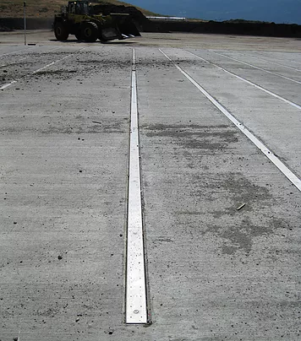
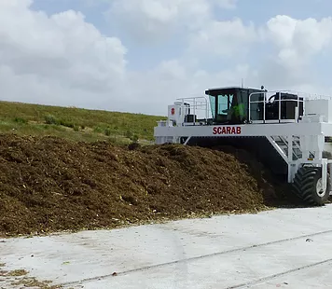
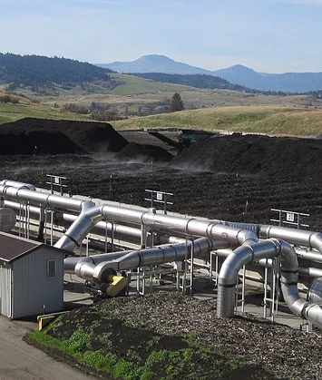
Compost Technologies
Aeration Floors
Aerated Turned Pile (ATP)
Aerated Static Pile (ASP)
*(Photos curtesy of Engineered Compost Systems, www.compostsystems.com)

Slide 23
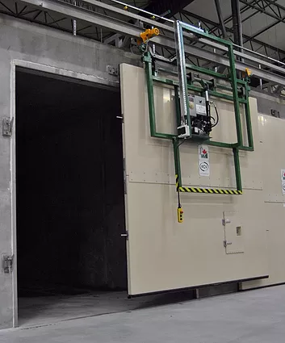
5
Compost Technologies
In-Vessel Tunnels
*(Photo curtesy of Engineered Compost Systems, www.compostsystems.com)

Slide 24
Compost Technologies
1. Aerated Static Pile - 36,000 tpy approx. 100 tpd
Capital cost ~ $ 3 M - $ 4 M
Includes- ASP Systems; Site Improvements; Process Equipment; Bio-Filter
Primary Retention – 18 days
Secondary Retention – 22 to 30 days
2. In Vessel SV Composter
Capital cost ~ $ 5.5 M - $ 6M
Includes- In- vessel units; Site Improvements; Process Equipment; Bio-Filter
Primary Retention – 18 days
Cure time varies based on materials
Operating Cost - $20 to $30 per ton * (Estimates provided by ECS)

Slide 25
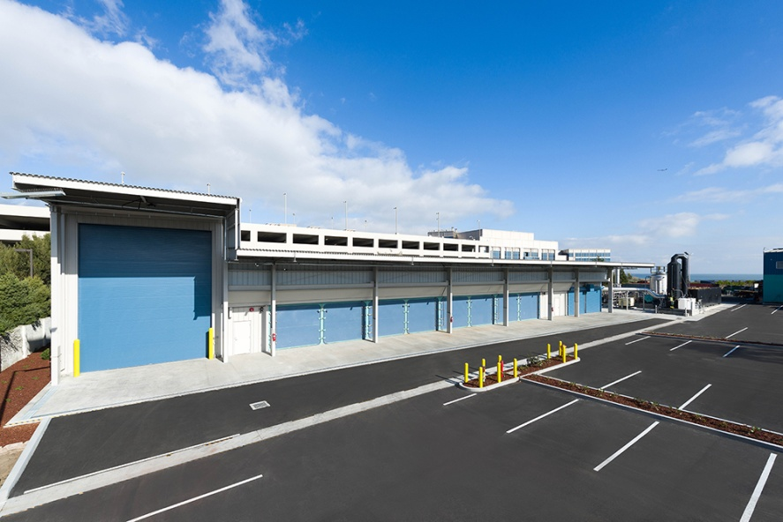
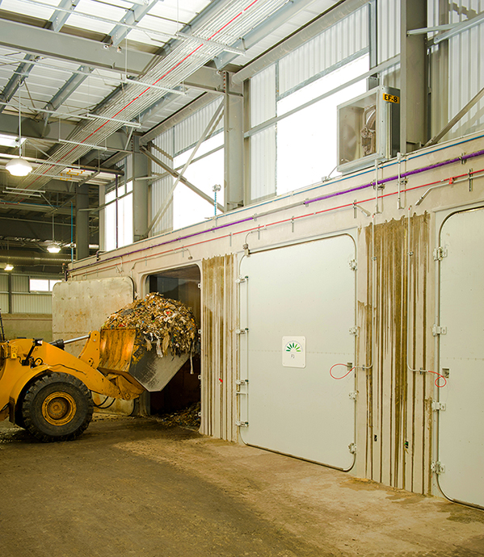
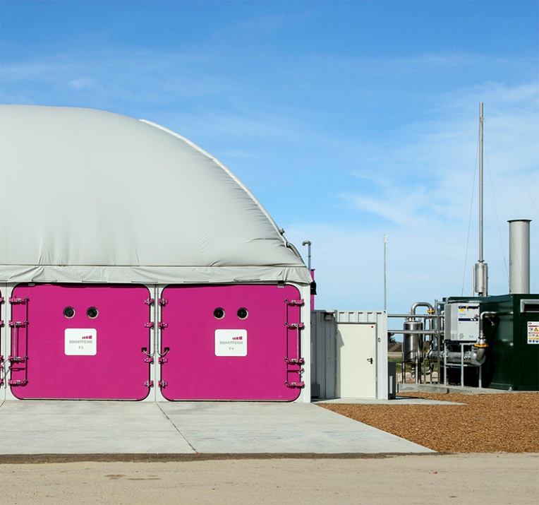
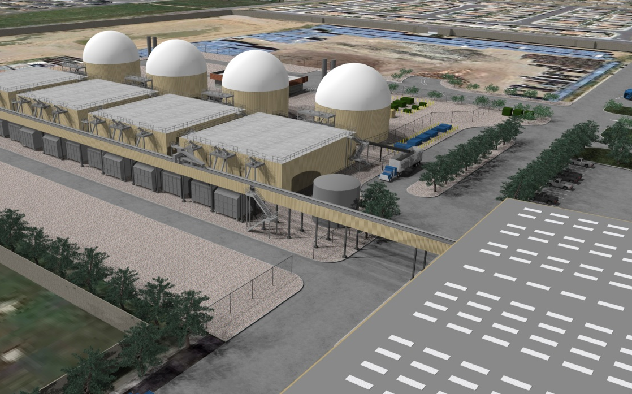
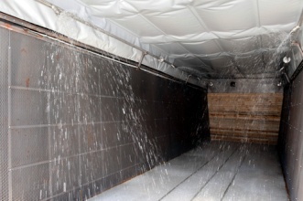
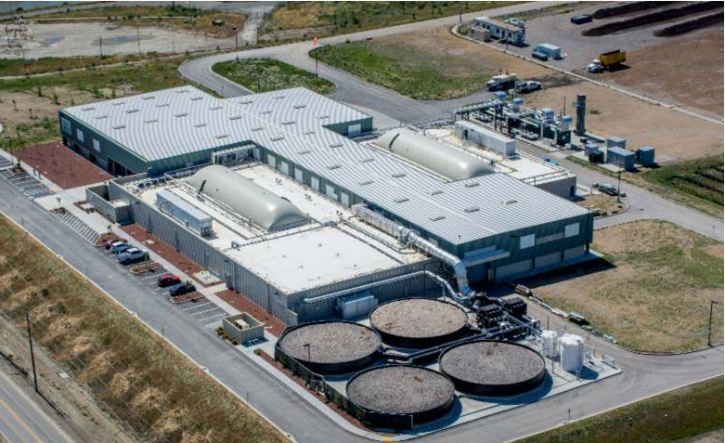
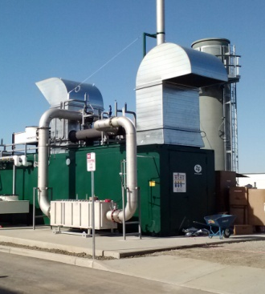
Organics – Anaerobic Digesters

Slide 26
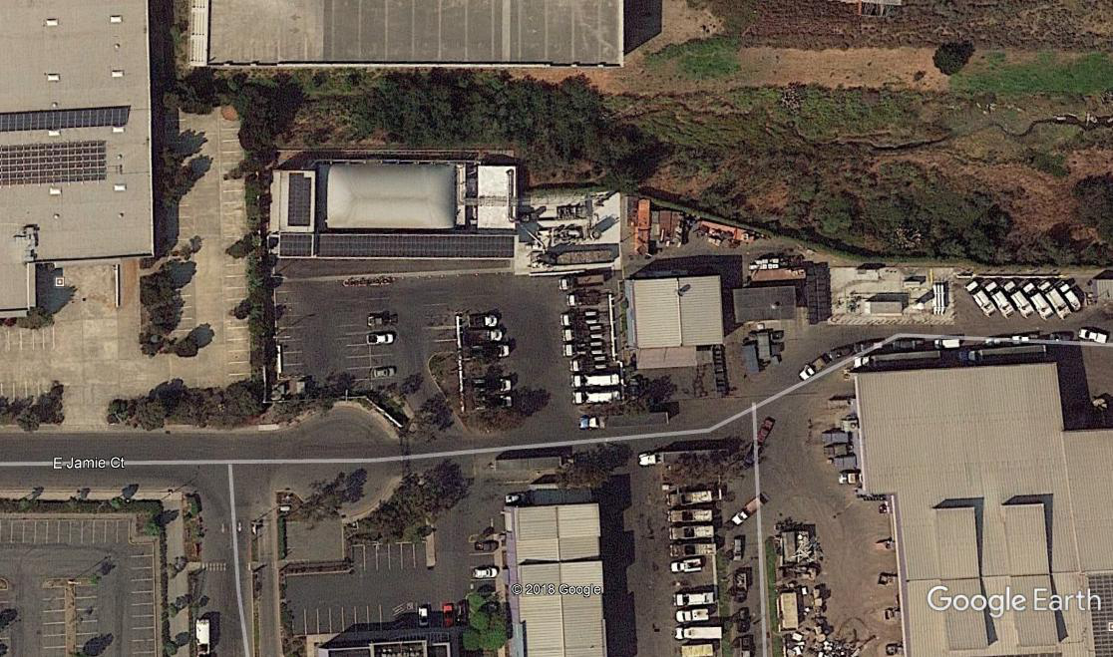
AD Processing Options
Blue Line -AD, South San Francisco
Processes – 11,5000 tpy - food waste/ yard waste and mixed organic
Generates compressed natural gas to fuel 18 collection trucks /day

Slide 27
Recycle Program Impacts Residential Food Waste Collection
Note: Focuses on Non-Packaging vegetative food waste

Slide 28
Recycle Program Impacts Residential + Commercial Food Waste Collection
Note: Focuses on Non-Packaging vegetative food waste

Slide 29
Recycling Options Discussion
Collection Options
Food /Yard Waste
Additional source separated materials
2. Processing
MRF Options -
Compost - enhanced technologies
AD

Slide 30
SWMP Schedule
Complete Draft SWMP – WR/R- 4/24 –SWAC
Board of Commissioners Briefing
Chapter 5 - Transfer Stations 5/29 - SWAC
Public Meeting – WR/R (Recycling options) -early June or Use June SWAC Meeting ?
Chapter 6 - Alternative Technology /Disposal Options 6/26- SWAC
Public Meeting – Disposal early July
Board of Commissioners Briefing
6. Chapter 6 and Draft Chapter 7 – Administration and Financial 7/31 - SWAC
DRAFT SWMP 8/28 – SWAC
Final SWMP in September

