Slide 1
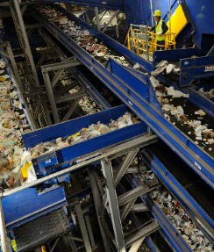
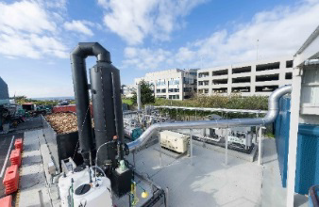
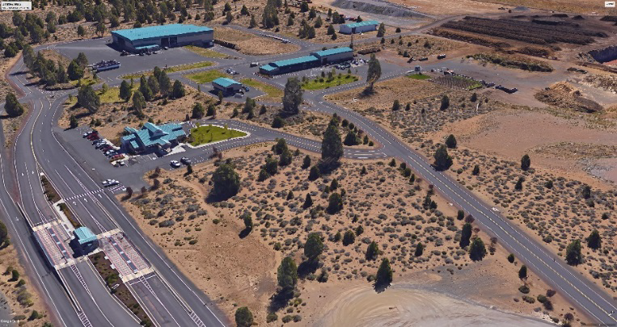
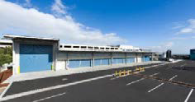

Slide 2
SWMP Planning Process
Agenda
Update of Chapters 1&2
Review revisions per SWAC
Chapter 3 – Waste Prevention, Reduction, Reuse, and Recycling Analysis
Regulatory Authority – ORS 459A
Background and Trends
Educational Programs
Outreach and Promotional Efforts
Recycling
Needs and Opportunities
Food Waste
C&D
Multifamily

Slide 3
Chapter 2 – Updates / Revisions
Diversification of the Economy (p.10)
Update on Tourism (p.11)
Recent Waste Composition Data (p.23-24)
Employment/ Population Information (p.25)
Growth Management Dept.
“Visit Bend”
DEQ
Growth Management Dept.

Slide 4
Diversification of the Economy
The Deschutes County seat is in Bend, which is considered the political and economic hub of Central Oregon. As the major population center for Central Oregon, Deschutes County has evolved into a diversified economic region. The main industries representing major employers include:
Leisure and Hospitality
Medical /Health Care
Industries
Secondary Wood Products
Aviation /Aerospace
Renewable Energy Resources
Recreation Equipment
Retail
Specialty Manufacturing
Office /Services
Government

Slide 5
Economic Data
Category | Year | Deschutes | Oregon
Median Household Income | 2015 | $51,223 | $51,243
Median Value of Owner Occupied Housing Unit | 2015 | $253,400 | $237,300
Civilian Labor Force | 2015 | 61.30% | 62.10%
Unemployment Rate (BLS) | Aug-17 | 4.20% | 4.10%
Full & Part Time employment | 2015 | 60,309 | 1,498,727
Total Employment- | 2015 | 6.80% | 3.80%
Percent Change
Total employer establishments | 2015 | 6,530 | 112,393
Building Permits | 2016 | 2,274 | 19,586

Slide 6
Tourism
“Visit Bend” Reported - 2.5 Million Visitor Trips in 2015
Assume 1 /trip - about 200,000 visitors / Mo.
25% Increase Over 2010
Information Represents City of Bend
Tourism Impacts Deschutes County Waste Stream
Higher per capita disposal rate ( Ave 20% higher)
Unique challenges to waste reduction and recycling programs

Slide 7
Verification of Waste Disposed
Waste Composition | % of Total Waste | Total Waste (Disposed+ Recyclables) (tons) | Waste Disposed (tons) | % Disposed | Recycled Materials (tons)
Total Paper | 26% | 62,198 | 40,272 | 25% | 21,926
Cardboard/ Kraft | 8% | 18,185 | 5,638 | 4% | 12,547
Clean Mixed Paper/ ONP | 7% | 15,822 | 6,443 | 4% | 9,379
Mixed Paper | 5% | 11,276 | 11,276 | 7% | -
Compostable / Soiled | 7% | 16,109 | 16,109 | 10% | -
Total Plastics | 6% | 14,327 | 12,887 | 8% | 1,440
Organics | 43% | 102,654 | 67,657 | 42% | 34,997
Yard Debris | 14% | 33,266 | 6,443 | 4% | 26,823
Wood | 9% | 22,330 | 16,109 | 10% | 6,221
Food | 18% | 42,701 | 41,883 | 26% | 818
Other Organics | 2% | 4,357 | 3,222 | 2% | 1,135
Glass | 4% | 9,786 | 3,222 | 2% | 6,564
Metal | 8% | 19,844 | 11,276 | 7% | 8,568
Aluminum | 1% | 2,230 | 1,611 | 1% | 619
Tin Cans | 1% | 3,549 | 3,222 | 2% | 327
Other (Scrap Metal) | 6% | 14,065 | 6,443 | 4% | 7,622
Other Inorganics | 9% | 21,584 | 19,330 | 12% | 2,254
Rock/ Concrete/ Brick | 3% | 6,033 | 4,833 | 3% | 1,200
Gypsum Wallboard | 2% | 4,833 | 4,833 | 3% | -
Electronics | 1% | 2,663 | 1,611 | 1% | 1,052
Misc. Organics | 5% | 11,278 | 11,276 | 7% | 2
Other Materials | 4% | 10,055 | 6,443 | 4% | 3,612
Motor Oil | 1% | 2,245 | 322 | 0.20% | 1,923
Other Materials | 3% | 6,522 | 4,833 | 3% | 1,689
Other Recyclables | 0% | 396 | - | 0% | 396
Total Waste | 100% | 240,844 | 161,087 | 100% | 79,757

Slide 8
Marion County 2016 Waste Comp
Materials | All Waste | Commercial | Mixed | Compacted | Self-Haul | Table 2-13 Disposed
Total Paper | 15.5% | 21.3% | 10.3% | 21.6% | 5.4% | 25%
Total Plastics | 12.2% | 15.0% | 10.9% | 27.6% | 5.4% | 8%
Metal | 4.8% | 5.7% | 5.0% | 2.1% | 5.7% | 7%
Commodities | 32.50% | 42.00% | 26.20% | 51.30% | 16.50% | 40%
Other Organics | 49.0% | 45.7% | 46.5% | 46.4% | 55.3% | 42%
Wood Waste | - | - | - | - | 26.2% | 9%
All Food | 15.5% | 29.0% | 2.8% | 20.6% | 2.9% | 26%

Slide 9
Employment / Population Info
City of Bend - Population Data
Census Data 2014 – 2016 – 3.9%
PRC – 2.18%
Verification growth in City / County is higher than rest of state
Will continue to use PRC

Slide 10
Diversification of the Economy
Category | Year | Deschutes County | Oregon Wide
Population | 2010 | 157,733 | 3,831,074
Population Estimate | 2016 | 181,307 | 4,093,465
Population percent change | 2010 - 2016 | 14.9% | 6.4%
Number of Housing Units | 2010 | 80,139 | 1,675,562
Number of Housing Units Estimate | 2016 | 85,933 | 1,732,786
Housing Units percent change | 2010 - 2016 | 7.2% | 3.4%

Slide 11
Employment / Population Info
Population Projections
Year | PSU Population Projections | Annual Growth Rate Period
2015 | 170,606 | ---
2020 | 190,734 | 2.4%
2025 | 210,826 | 2.1%
2030 | 230,412 | 1.9%
2035 | 249,037 | 1.6%
2040 | 267,798 | 1.5%

Slide 12
Review of Chapter 1 & 2
Purpose of SWMP
“To work cooperatively with Cities and service providers to offer citizens and businesses an integrated solid waste management system that delivers quality and cost-effective services while achieving the best use of our resources and reducing waste disposed in landfills.”

Slide 13
Review of Chapters 1 & 2
1. To provide an integrated solid waste management system that addresses an effective combination of strategies and programs guided by the hierarchy adopted by the state.
2. To continue educating consumers in order to promote practices and methods to reduce the long-term per capita waste generation rate.
3. To develop programs and support implementation of system improvements that seek to ensure materials recovered from the waste stream attain the highest and best use and are recycled.
4. To develop a solid waste system that is based on sound financial principles, provides cost effective services and maintains rate stability over a long term, while allocating costs equitably to all users.
5. To maintain system flexibility to respond to changes in waste stream composition, waste management technologies, public preferences, new laws and changing circumstances.

Slide 14
Key Issues
Current recovery rate is 36%. New goal is 45% by 2025.
Address impacts based off the current collection services, considering the growth in population.
Consider strategies to extend the site life of Knott Landfill
Chinese National Sword & Recyclable Commodities Market
Notes:
With limited remaining capacity at Knott Landfill, right now is the time to reduce waste generation, and increase diversion

Slide 15
Chapter 3 - Waste Prevention/Reduction, Reuse and Recycling
Background
Needs and Opportunities
Alternatives Discussion

Slide 16
Chapter 3 - Background
Between 1990-2009, Deschutes County invested more than $1.8 million to expand its waste prevention and recycling education program
2.5% of County’s annual budget
FY 2017-2018: County budgeted $110,000 towards these efforts
57% population growth rate since 2000
Average 200,000 visitors per month
Notes:
Perhaps combine Background and Key Issues slides

Slide 17
Regulatory Authority
ORS 459A.007 – Outlines necessary planning elements for robust recycling program = “Opportunity to Recycle”
ORS 459A.008 – Guidance for educational and promotion programs designed to encourage more sustainable behavior
ORS.459A.010 – Statewide goals for recovery rates
Notes:
Other relevant regulatory statutes as covered in previous presentation:
ORS 459 – Cities and Counties have similar requirements to ensure basic services for collection. Recycling and disposal services are provided to all residences and businesses
State supports local government coordination (ORS 459.065)
Prepare SWMP’s
Joint Implementation of facilities
Related to new landfill (ORS 459.017)
A local government prepares SWMP that identifies need for a landfill
State will work local government to site permit and implement a new landfill disposal site.

Slide 18
Regulatory Authority
ORS 459A.007 – Outlines necessary planning elements for robust recycling program = “Opportunity to Recycle”
Programming Elements A-M
Deschutes obligated to satisfy Elements A-C plus any; OR Any five Elements
ORS 459A.008 – Guidance for educational and promotion programs designed to encourage more sustainable behavior
ORS.459A.010 – Statewide goals for recovery rates
Notes:
ORS 459 – Cities and Counties have similar requirements to ensure basic services for collection. Recycling and disposal services are provided to all residences and businesses
‘Population greater than 10,000… located more than 150 miles from Portland’
Deschutes is regulated to implement Elements A-C and any additional Element, or at least five Elements

Slide 19
Regulatory Authority
ORS 459A.007
Elements A-F
Element | Status | Status
Element A: Provide curbside recycling container | Status: All cities are meeting this requirement because the haulers provide residents curbside recycling. | ✓
Element B: Provide weekly curbside recycling | Status: Recycling services in all cities and the urbanized portions of the County are offered every other week. This element is not satisfied. | X
Element C: Expanded recycling education and promotion program which includes a contamination reduction education plan. | Status: The Environmental Center together with local collection companies has implemented and expanded programing to promote reduction and recycling. All collection companies submitted plans to DEQ as to how they are reducing contamination. | ✓
Element D: Provide multi-family recycling to apartment complexes that request it. | Status: Haulers provide recycling services to those that request it; participation is not mandatory. | ✓
Element E: Curbside yard debris collection is available to residential collection service customers at least once a month, and depots that accept yard waste are conveniently located | Status: Yard waste is offered on subscription-only basis in the incorporated cities only and all but one recycling depot (Alfalfa) accept yard waste | ✓
Element F: Recycling is available to businesses and schools. | Status: All cities meet this requirement since haulers offer this service. | ✓
Notes:
A review of Deschutes County’s programs suggests that the County is compliant with the direction of ORS459A.007. In fact, the County satisfies several elements beyond what they are required. Some of the program elements that the County does not satisfy at the moment, which are intended to increase wasteshed recovery rates are further evaluated later in this chapter. Nonetheless, in keeping with the objectives of 459A.007, the County, cities and franchised haulers have implemented several waste reduction initiatives described below.

Slide 20
Regulatory Authority
ORS 459A.007
Elements G-M
Element | Status | Status
Element G: There is a recycling depot available for every 25,000 residents. | With 181,000 residents and 8 recycling drop off centers located throughout the County for average of about 1 per 22,600 people. These are operated either by the County or other parties. | ✓
Element H: Weight based collection rates that encourage reduction, reuse, and recycling | No cities use weight-based rates. However, the current rates provide incentives for customers to use smaller containers to reduce waste disposal. | ?
Element I: Food composting /anaerobic digestion is available for businesses. | Composting is available for commercially generated food waste. No anaerobic digestion is taking place. | ✓
Curbside food composting /anaerobic digestion is available for residents. | All cities above 4,000 have residential curbside food collection available. There is no food waste collected in the County Food waste is then composted. No anaerobic digestion is taking place. | ✓
NEW Element L: Cities require recycling program for construction/demolition (C/D) (6 cy for self-haul, 10 cy for collection service) | Source separated C&D waste is recycled to the extent it is possible, however a significant amount is brought directly to landfill. | X
NEW Element M: Cities require food waste program for large generators (50 tons/yr). | No cities require large generators to divert food. | X

Slide 21
Outreach and Promotional Programs
ORS 459A.007 – Outlines necessary planning elements for robust recycling program = “Opportunity to Recycle”
ORS 459A.008 – Guidance for educational and promotion programs designed to encourage more sustainable behavior
Emphasize environmental benefits of reduction
Provide direction to reduce waste and recycle more
Partnership with NGOs, schools, citizen volunteers, and businesses
Regular distribution of outreach and educational material
ORS.459A.010 – Statewide goals for recovery rates
Notes:
Enlisting the residents, commercial businesses and institutions in waste recovery efforts is key to program participation and success.
Providing businesses and citizens with the information necessary to appreciate and properly use the recycling services available to them is critical.
Through partnerships with local environmental groups, citizen volunteers, schools, and companies involved in solid waste management, the County has developed a solid waste education outreach, promotion, and advertising program for recycling, composting and other waste reduction and reuse efforts

Slide 22
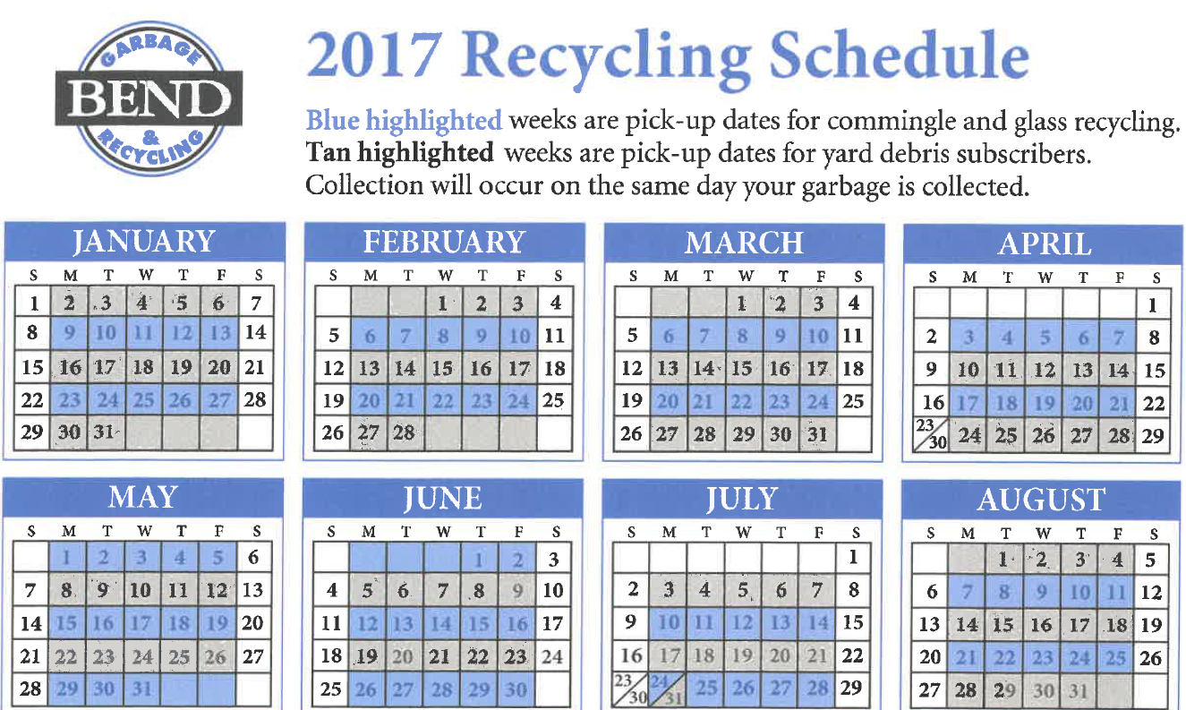
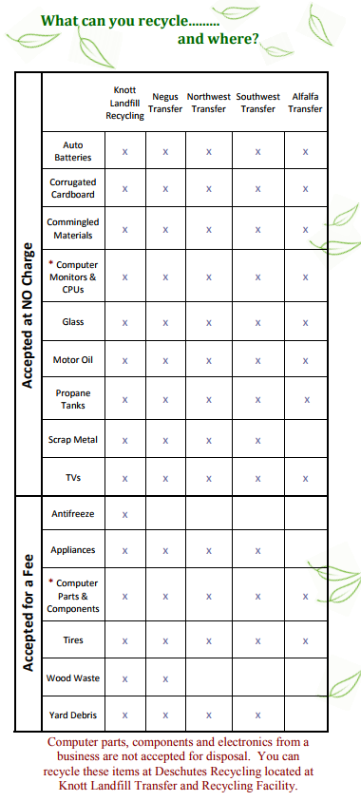
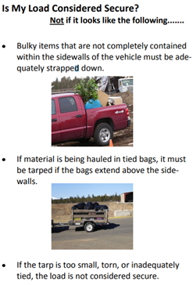
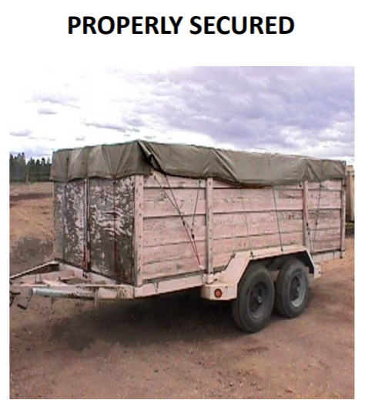
Outreach and Promotional Programs con’t
Brochures and promotional materials distributed regularly
Secure your load brochure
Notes:
Left to Right:
HHW brochure distributed by Deschutes County Dept. Solid Waste
Section from BGR Collection Brochure distributed to customers
Section from Cascade Disposal distributed to rural customers
Deschutes County Dept Solid Waste, “Secure Your Load” Brochure
Department of Solid Waste’s Recycling brochure specifies the materials collected, facility hours and collection schedules, how to prepare recyclables for collection so as to reduce contamination, and why source-separating materials is necessary. The brochure explains which recyclable materials can be commingled and that they are free to recycle. Other recyclable materials that can be collected for free but must be separated from commingled materials include auto batteries, corrugated cardboard, electronics, glass, and household hazardous waste (HHW).
There is also information about non-recyclable materials, such as polystyrene. The brochure encourages residents and businesses to avoid buying these non-recyclable materials, as well as provides keen insights into re-using consumable goods. Distinct information about each material, respective fees and at which facility they are accepted is also organized in the brochure
Each collection company in Deschutes County also offers promotional materials and programming to keep their customers aware of scheduling, how to prepare recyclables for collection, and to encourage participation

Slide 23
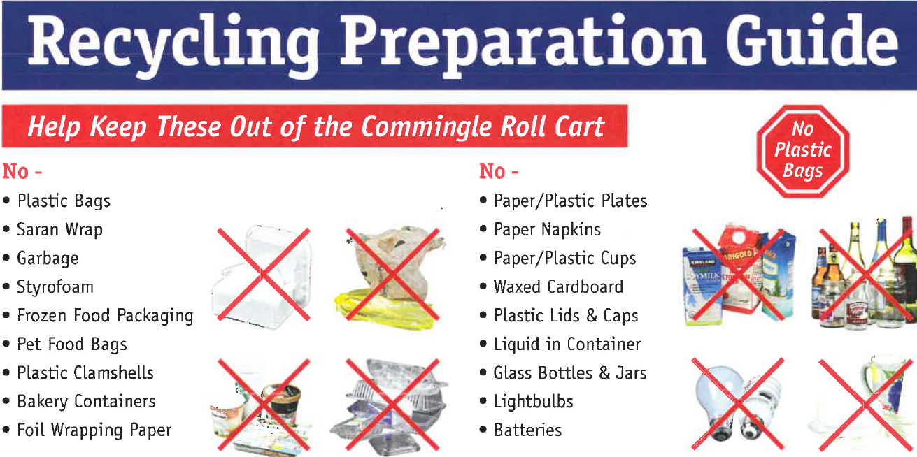
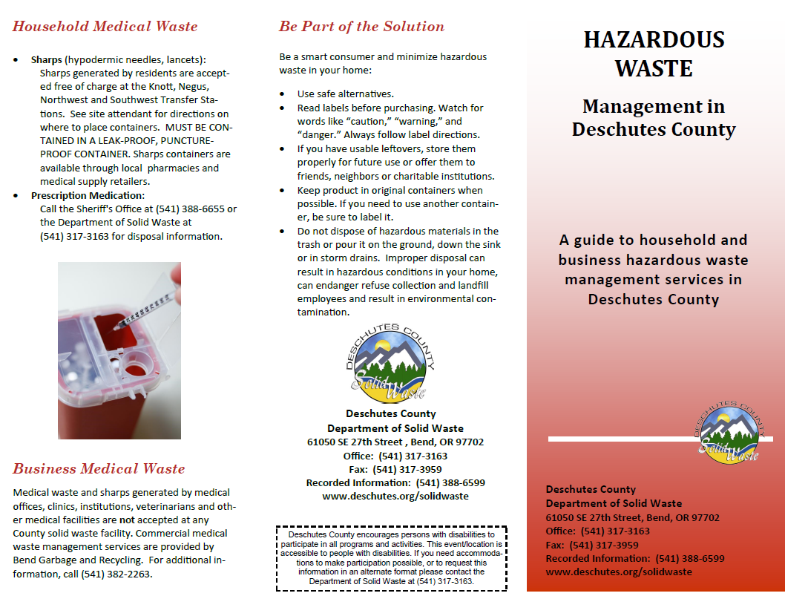
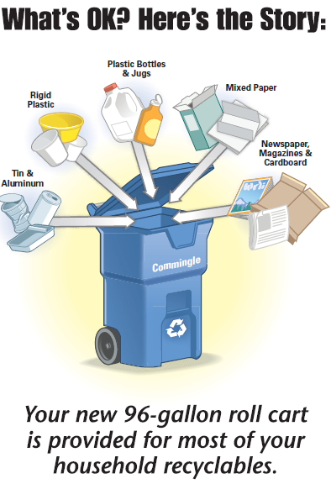
Outreach and Promotional Programs con’t
Guidance for preparing waste for collection, why it’s necessary
Notes:
From Left – Right
HHW brochure distributed by Deschutes County Dept. Solid Waste
Section from BGR Collection Brochure distributed to customers
Section from Cascade Disposal distributed to rural customers
Contamination notification
Customers are notified of contamination in their pickups
If unaddressed, customer service representatives from collection companies will call customers to inform them as well

Slide 24
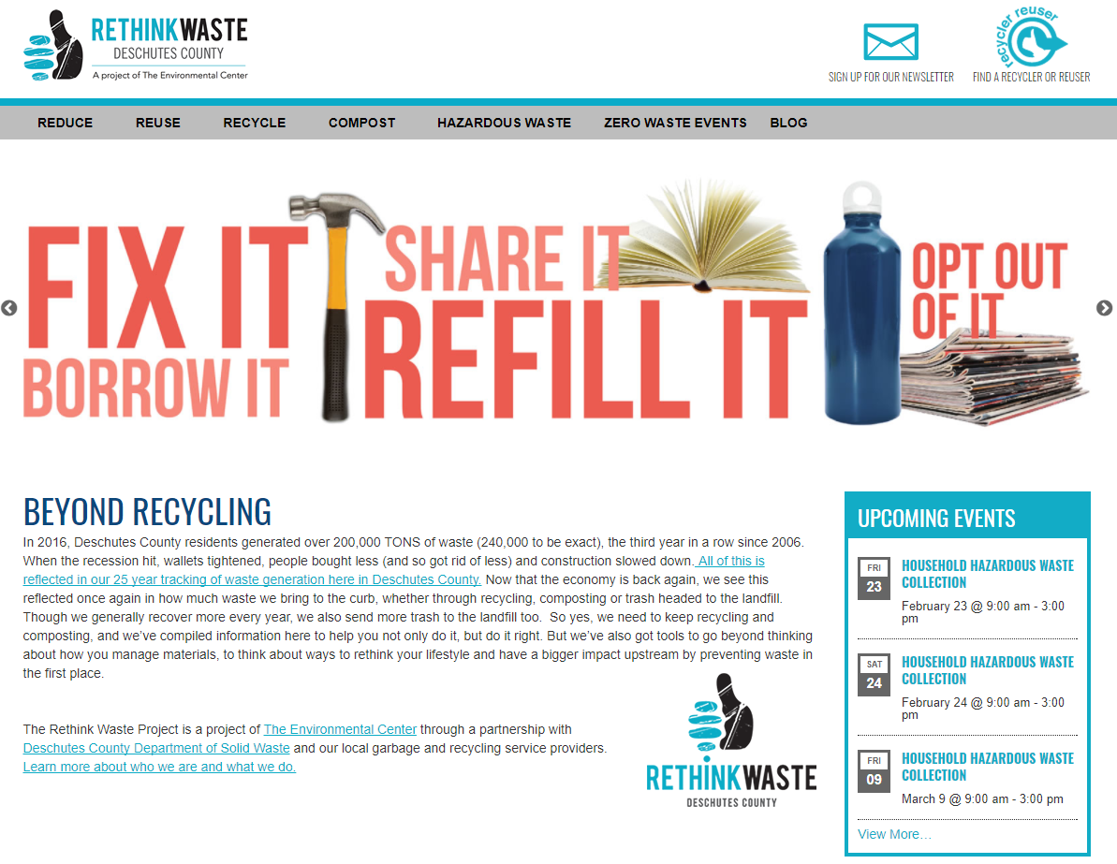
Key Educational Programs
Environmental Center and Rethink Waste
EarthSmart youth education
Oregon Green Schools
Notes:
L to R: rethinkwaste project homepage; Rethink Waste Brochure for Repair Café; Logos
The Environmental Center is a grassroots environmental sustainability organization focused on Central Oregon, and has taken the lead in promoting educational programs and technical support to schools in Deschutes County. Together with the County’s Department of Solid Waste and local waste and recycling service providers, The Environmental Center launched the “Rethink Waste Project” in 2011. This was initially circulated as a print guide to offer Deschutes residents information about the needs and ways they could more sustainably handle their waste. A corresponding website www.rethinkwasteproject.org was assembled as well, and in 2015 the site was updated with the assistance of a local design company to improve marketing efforts.
Earthsmart:
The Environmental Center also hosts the “EarthSmart” youth education program, offering information for grades K-12 on waste-related topics. The objective of this program is to educate young students about the environmental implications of their behavior, encouraging them to reduce their footprint whenever possible. In the 2016-17 academic year, The Environmental Center gave 172 presentations in schools and community centers, reaching an audience of 5,029 students. Twenty-one (21) classes and eight (8) schools took part in the EarthSmart program that included six (6) lessons and a field trip to a landfill. More than 450 students toured the Knott Landfill as a result. In addition, funding from this program also enabled a school to have a guest speaker educate students about import and various ways they can reuse plastic bags.
Oregon Green Schools:
Oregon Green Schools, a nonprofit organization formed in 1997, is another education-oriented initiative that promotes environmentally sustainable behavior in schools across the state by offering varying degrees of certification. A key component of the Green Schools program is waste reduction and recycling. Schools in Deschutes that want to become a certified Green School can work with The Environmental Center’s educational program to achieve certification

Slide 25
Waste Trends (2006-2016)
Generation vs. Recovery
Recovery Rate
County recovery rate is in flux, significant progress needed to achieve 45% recovery rate by 2025
Takeaway: No clear correlation between generation and recovery = Enhance recovery efforts
Notes:
Figure 3 - 2 illustrates the county’s recovery rate (equal to the per capita recovery rate) from
2006 through 2016. It is difficult to ascertain a meaningful relationship between the
generation and recovery rate, but notable is that in 2006 when the county’s generation
peaked, it was also paired with the lowest rate of recovery rate (27%). During this time the
county’s recovery rate in relative terms peaked at 39% in 2011 and 2012; however, 2015
saw the greatest amount of recovery in absolute terms with 975 pounds per capita being
recovered versus 914 pounds per capital being recovered in 2011

Slide 26
Material Recovery Trends (2014-2016)
Notes:
Based on Table 3-1 and Figure 3-4 it appears that, with a few exceptions, the general recovery rate of materials overall has remained consistent between 2014 and 2016. Noteworthy increases are observed in the amount of organic waste recovered as yard waste (32%), wood waste (61%), and food waste (27%) recovery shares grew overall. The increasing prevalence of wood waste may be attributable to more construction and development in Deschutes. Additionally, the recovery of household hazardous waste displayed remarkable growth from 155 tons in 2014 to 264 tons in 2016, an increase of 70%. In contrast, the recovery rate of corrugated cardboard declined 10% during this time, which is worth further study considering the rapid growth of this material in the waste stream with the advent of online shopping. Similarly concerning is a seemingly anomalous reduction in the recovery of scrap metal, down 41% from 2014 levels. Further research is necessary to analyze trends in these data.

Slide 27
Significant Tonnages and Materials (2016)
Source | Amount (tons)
Commingled Recyclables from Franchised Haulers | 13,000
Materials from Transfer Stations | 1,800
Yard Waste (Deschutes Recycling) | 26,800
Food Waste | 820
Paper products | 22,700
Scrap Metal | 7,700
Plastic products | 10,400

Slide 28
Impacts of National Sword
China is single largest consumer of recyclable materials. In 2018 China established a new standard for contamination limits of recyclable materials at 0.5%.
Impacts
Levels are not practical without improvement in MRF processing technology – result will be higher costs
US markets also putting demands form cleaner materials from MRFs’
Pacific NW hit hard due concerns of moisture and lack of technology
Must get more aggressive to firm up US market
Demand and prices for quality materials is secure

Slide 29
Recent Commodity Prices Pacific Northwest (Feb. 2018)
Primary | Secondary | Commodity Price ($/ton)
Paper
 | Fine, Computer, Office | $150
 | Newsprint | $100
 | Old Corrugated Cardboard (OCC) | $85
 | Boxboard | $58
 | Magazines | $100
 | Books | $165
Plastic
 | Film | $80
 | PETE Containers | $220
 | HDPE Natural | $520
 | Rigid (non-beverage) | $220
Metals
 | Ferrous | $200
 | Non-Ferrous (copper, aluminum, brass) | $1,360

Slide 30
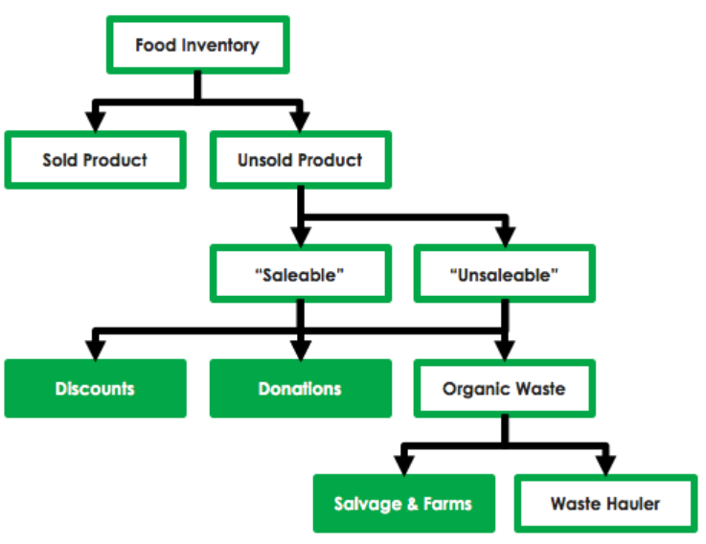
Needs & Opportunities
Target: Food Waste
Problem: Food waste is largest uncaptured segment of waste stream (42,000 tons +); more from restaurant tourism
Solution: Element I (commercial); Element K (residential); Element M (large generators)
Notes:
Spolier Alert – An application that allows food producers, wholesale and retail distributors to manage unsold inventory to enhance food recovery and waste diversion efforts, and enables real-time food donations and discounted sales.
GoMkt – An web-based platform that helps food retailers reduce food waste and increase recovery efforts by posting unsold inventory to users and food banks at heavily discounted prices.
Karma – A similar Swedish app that recently expanded to London

Slide 31
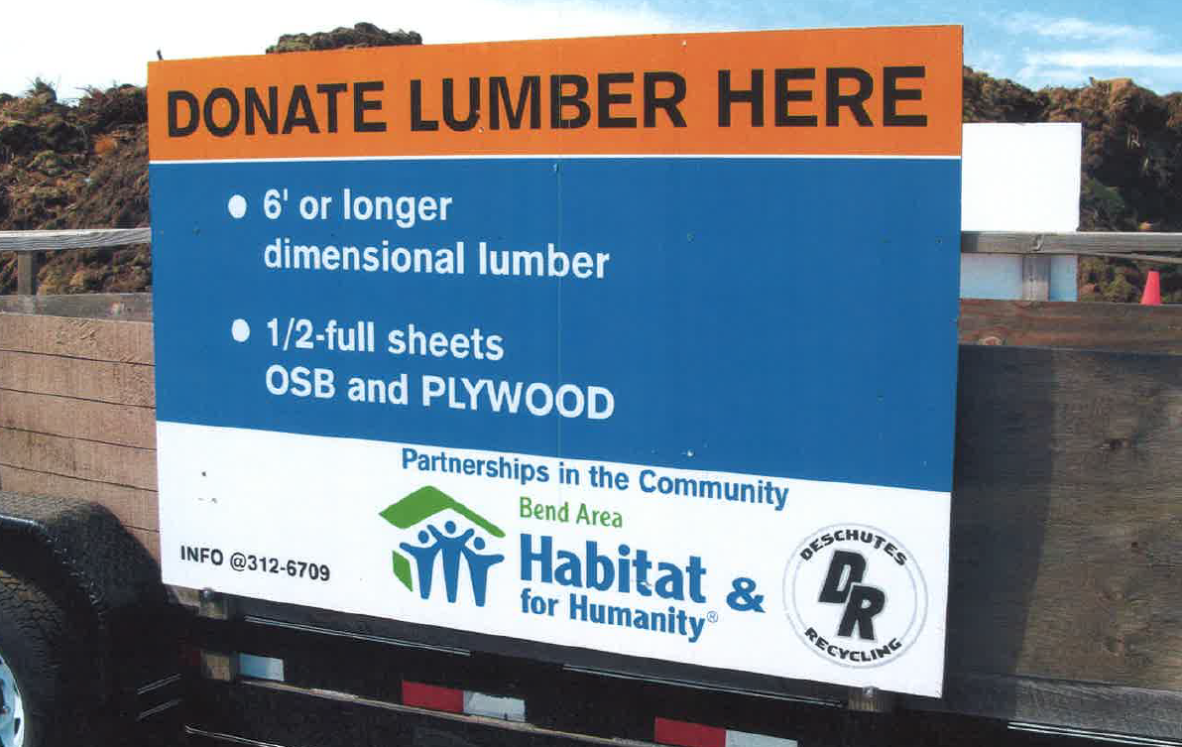
Needs & Opportunities con’t
Target: C&D Debris
Problem: C&D is heavy, highly recyclable, difficult to compact, occupies valuable landfill space
Solution: Element L
Notes:
It appears that more 30% of the waste disposed at Knott Landfill is generated from C&D activities. Developing alternatives for recovering more materials and locating a separate disposal site for inerts could increase the site life of the Knott Landfill if implemented in the near future. It may also provide long term benefits to the system by avoiding the transportation to a disposal site located further from where C&D is generated. \
Element L → Requires source separation of C&D debris OR it has to be brought to a MRF for processing.
Lobby that it be a pre-requisite for construction permits that contractors either commit to source separation or have identified a facility that can process C&D material.

Slide 32
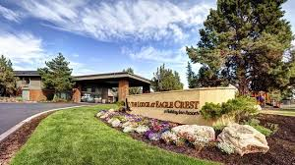
Needs & Opportunities con’t
Target: Multifamily
Problem: Limited multifamily program; ties into tourist population
Opportunity: Increased service to high-density rural
Solution: Element D
Notes:
Empire Village Townhomes
888-879-7015
20814 Sierra Dr., Bend, OR 97701

Slide 33
Needs & Opportunities Summary
Chapter 3 – Waste Prevention, Reduction, Reuse, and Recycling Analysis
Residential Yard Waste/Food waste
Commercial Food Waste
Upgrade organic waste processing facilities
Construction & Demolition Debris
Focus on Tourism
Multifamily Recycling

Slide 34
Alternatives
3.5.1 Enhance Current Promotion/Education/Support Services
Enhance Commercial Recycling – Working with the franchise haulers services to offer expanded collection of source separated materials may also be necessary.
Upgrade Special Events Recycling Program – Communities are making efforts to execute a “ Zero Waste” program in conjunction with sporting venues, fairs or other special events.
Continue Waste Reduction/Recycling Grants – Grants can be effective in introducing pilot programs and/or starting new services. These can also be advertised to gain additional promotional benefits.
Encourage hotels and tourist centers to promote recycling – Year round tourism is large contributor to the cities and countywide economy, and with the number of tourists rivaling, if not exceeding the number of residents in the County at any given time, it can be expected that tourists account for a substantial sum of the waste generated

Slide 35
Alternatives con’t
3.5.2 Target Certain Types of Generators or Waste Streams to Increase Diversion by Expanding Basic Services
Recyclables such as Cardboard and Scrap metal in commercial waste stream and multifamily
Expand Residential Curbside Services –Expand curbside collection of commingled recyclable materials to serve rural areas.
Increase Multi-family Housing Recycling Program – More multi-family dwelling units are being built to accommodate growth. Developing a focused education/ promotion programs in conjunction with enhanced methods to provide convenient services could contribute to achieving the county’s recovery rate.
Promote Increased Diversion of Electronic Devices from the Waste Stream
Provide More Reuse Diversion Opportunities through innovated technologies such as food waste applications
Spolier Alert – An application that allows food producers, wholesale and retail distributors to manage unsold inventory to enhance food recovery and waste diversion efforts, and enables real-time food donations and discounted sales.
GoMkt – An web-based platform that helps food retailers reduce food waste and increase recovery efforts by posting unsold inventory to users and food banks at heavily discounted prices.

Slide 36
Alternatives con’t
3.5.3 Target Recovery of New Materials
Divert More Dry Waste Materials for Processing at MRF – This would require commercial businesses to separate food waste from dry waste. The dry waste may be acceptable to be processed along with the residential curbside materials at a materials recovery facility (MRF)
Implement Food Waste Recycling Program(s)
Consider a Textile Recycling Program
Investigate C&D stream and target certain materials such as wood, metals and fibers –With more than 30% of the waste disposed at Knott Landfill generated from C&D activities, developing alternatives for recovering more materials and locating a separate disposal site for inerts could increase the site life of the Knott Landfill if implemented in the near future. It may also provide long term benefits to the system by avoiding the transportation to a disposal site located further from where C&D is generated.

Slide 37
Next Steps
Post Minutes on Web site
Develop and Evaluate Waste Prevention / Reduction, Reuse and Recycling Alternatives
Prepare Chapter 4 - Collection
Existing Conditions
Needs and Opportunities
List Alternatives
Next SWAC Meeting –March 27

