Slide 1
Deschutes County Cannabis Advisory panel October 23rd , 2023
Cannabis water use and OWRD enforcement
Jeremy Giffin– Deschutes Basin Watermaster, WRD

Slide 2
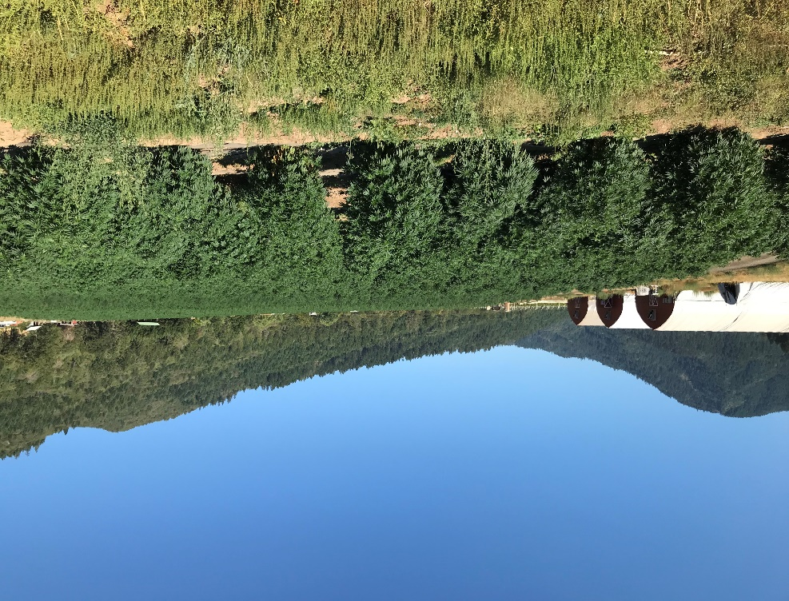
Groundwater exempt uses
ORS 537.545
15,000 GPD Domestic
5,000 GPD Industrial/Commercial
½ acre Lawn/non-commercial garden
Stock Watering
Fire Control
No irrigation with intent to sell product!
Notes:
History and Legislation that brings us into our 2022 report.
Go through our regulatory activities and audits from the past year
Discuss the Interagency collaboration that has resulted from the program and the team's work.
And take a look at how field work has evolved before taking a look ahead.

Slide 3
Surface Water exempt uses
ORS 537.141
Natural Springs that arise and fall on property
Stock watering
Fire Control
Rainwater collection from impervious surface
Fish protection

Slide 4
Deschutes County 2023 Numbers
 | OLCC (high THC) | ODA (Hemp) | Unregistered | Total
Total sites in Deshutes County | 54 | 9 | 4 | 67
WR researches performed | 54 | 9 | 4 | 67
Site Visit Investigatins | 9 | 6 | 4 | 19
Law Enforcment Colaboration (Raids) | 0 | 0 | 3 | 3
Sites with Violations of Water Law | 1 | 1 | 2 | 4
All data is for Deschutes County for the dates 1/1/2023 - 10/12/2023 performed by OWRD Cannabis Team

Slide 5
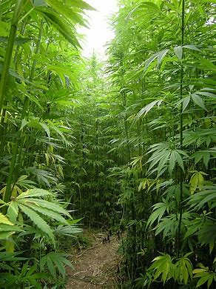
History and Legislation
2018 US Farm Bill passed, paving the way for legal hemp production
2019 Significant increase in complaints on ODA Hemp Program sites
ODA funded Special Assistant Watermaster Position at OWRD for 2020 and 2021
2020 Hemp Water Use Audit in SW region of the state investigating water use at ODA registered hemp sites
Notes:
The 2018 U.S. Farm Bill paved the way for legal hemp agriculture in the United States. The Oregon Department of Agriculture (ODA) was tasked with managing this new industry, creating guidance to be reviewed by the United States Department of Agriculture, registering sites, and ensuring THC testing is done prior to harvest.
In the fall of 2019, with increased complaints specific to water use as hemp production in Oregon increased, ODA and OWRD staff discussed water usage, compliance, and staff capacity. ODA offered to pay for a limited duration Assistant Watermaster to investigate hemp production sites for water law compliance with a focus in the Southwest Region.
2020 Hemp Audit, The new ODA funded position focused on ODA Hemp Registered sites. Auditing water use, collecting information, and performing compliance activity. Some of that data will be displayed later in the presentation.

Slide 6
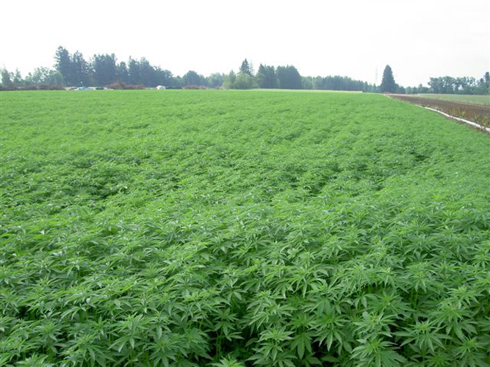
History and Legislation
SB 5561
5 Million in funding for OWRD.
14 new Cannabis Assistant Watermasters, Enforcement Section
HB 4061
Water Use on Cannabis Sites
Water Haulers and Suppliers
Documentation & Penalties
2022
New AWM’s Hired and Water Use
Audits Expanded
Notes:
SB 5561 - The $5 million funding package passed during the December 2021 Special Session funded 29 permanent, full-time positions, created a new Enforcement Section, and gave funding for better data tools and technology.
14 of the 29 new FTE positions are cannabis focused assistant watermasters. These assistant watermasters respond to complaints, investigate illegal water use, coordinate with partner agencies and LE, and support overall agency enforcement processes across the state.
House Bill 4061 (2021) went into effect in June of 2022. It focuses on water use at cannabis-growing sites. The bill applies to water suppliers, water haulers, and cannabis growers of both hemp and marijuana.
OWRD worked alongside OLCC and OHA to implement and enforce the new requirements and use our existing authority to assist law enforcement with investigations.
Under 4061, water suppliers and water haulers have new documentation requirements and record retention for all irrigated Cannabis and Hemp crops. Cannabis producers may face increased penalties for unauthorized water use or hauling water to a farm that has not been licensed with the OLCC, ODA, and Oregon Health Authority. OHA has a small percentage of registered sites for medical cannabis and as a result is not broke out in this presentation.
2022 – Focused on the recruitment, training and program development of the SB 5561positions and cannabis enforcement program to expanded the compliance and audits statewide.

Slide 7
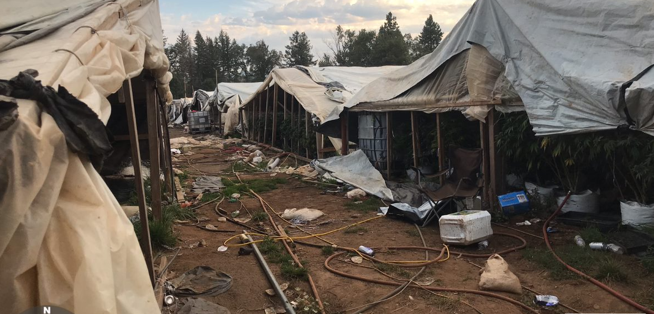
Regulatory Activities
Notes:
Typical Unregistered Site in the SW. You can see why this work is important and of great concern to the community. This is in Josephine County. Illegal Appropriation and Storage of GW, Fertilizer Mixing Taking Place in Tanks with No Backflow prevention devices preventing those chemicals entering GW thorough domestic wells and well construction violations among other NR Agency Violations.

Slide 8
Desktop Investigation Results
Over 2,218 desktop investigations were performed by department staff in 2022. This included all licensed OLCC sites, all ODA registered sites and all illicit sites made known to the team*
These investigations revealed 811 or 37% of sites had no water rights
Cannabis Type | Percent Without Water Rights
Licensed OLCC | 35%
Registered ODA | 29%
Unregistered Cannabis | 75%
All Cannabis | 37%

Slide 9
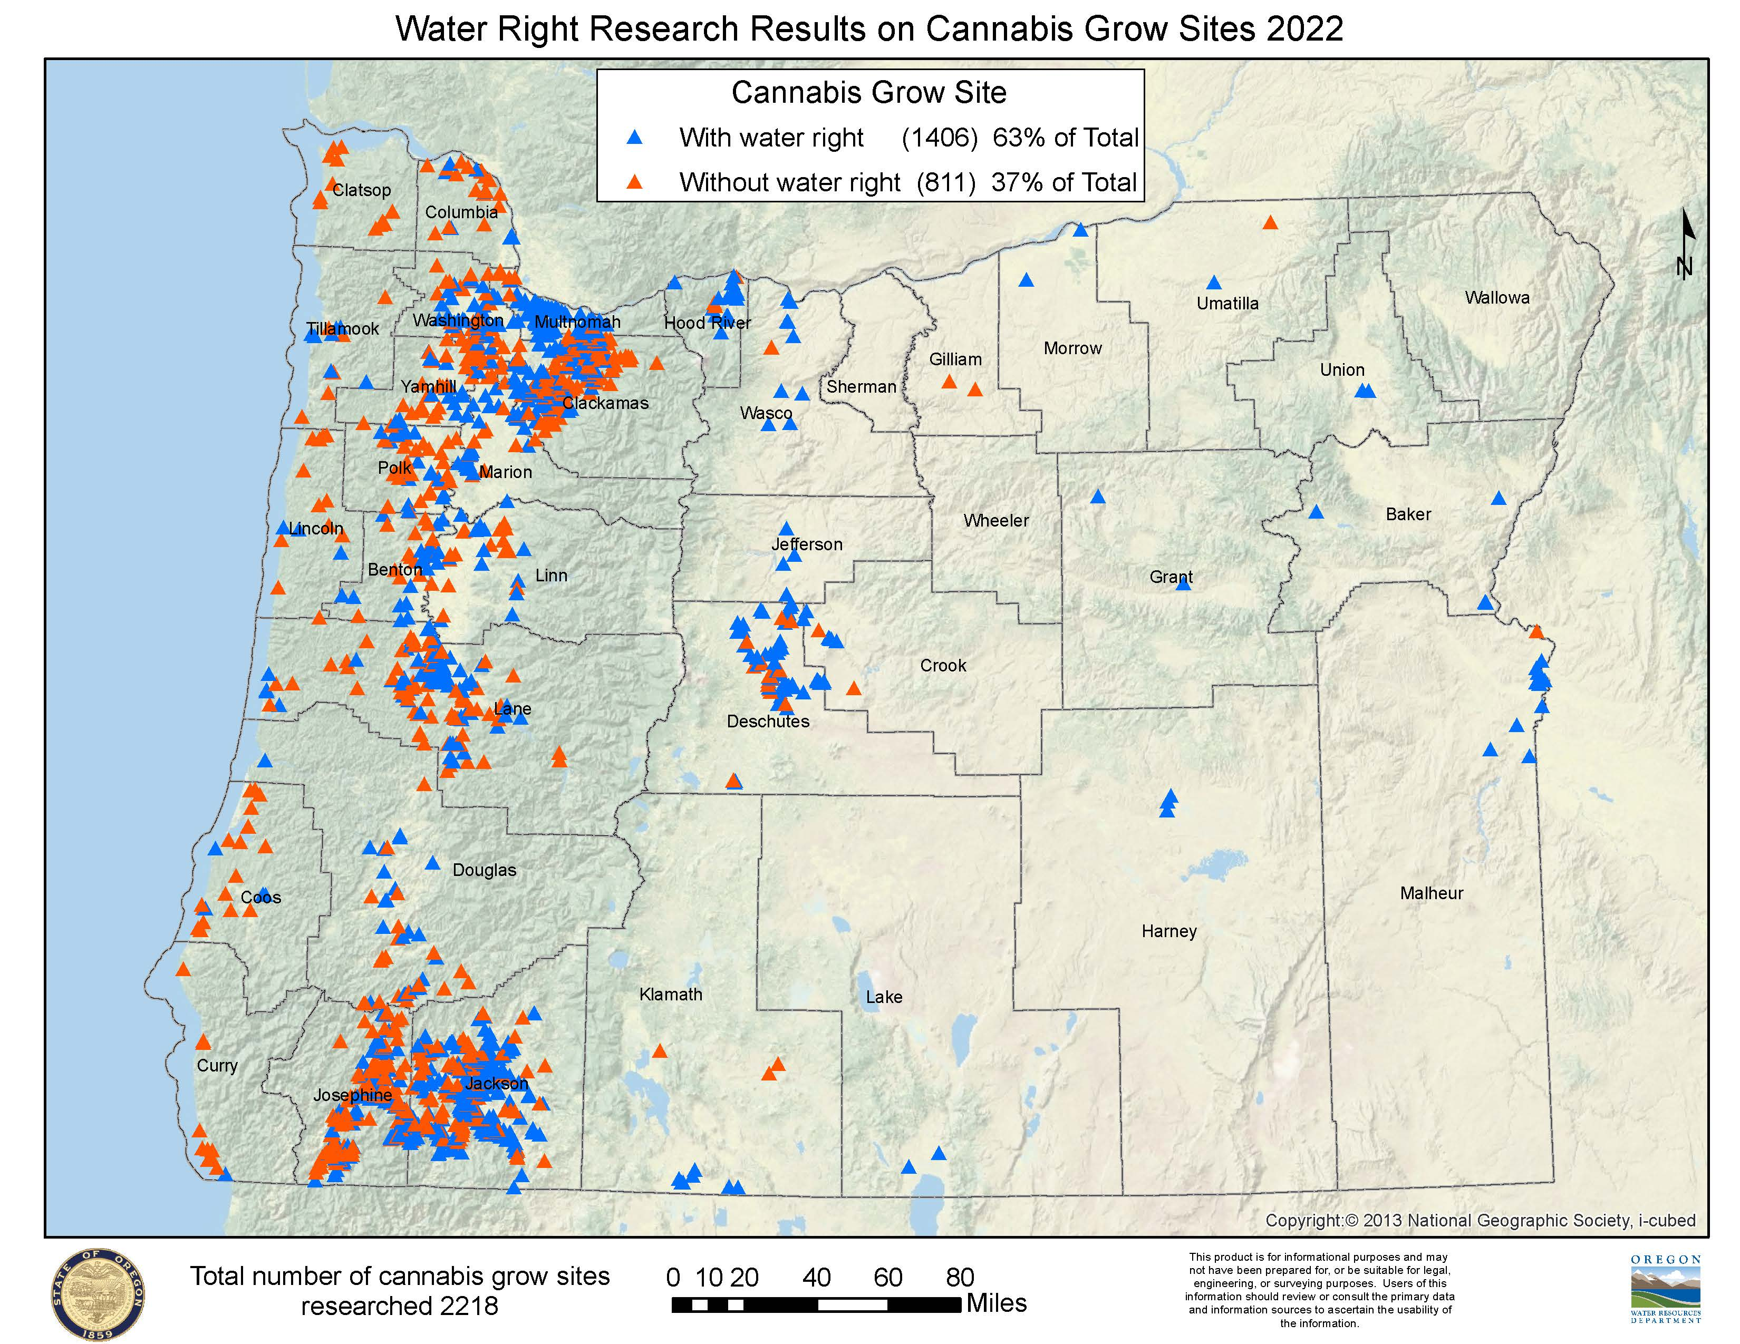

Slide 10
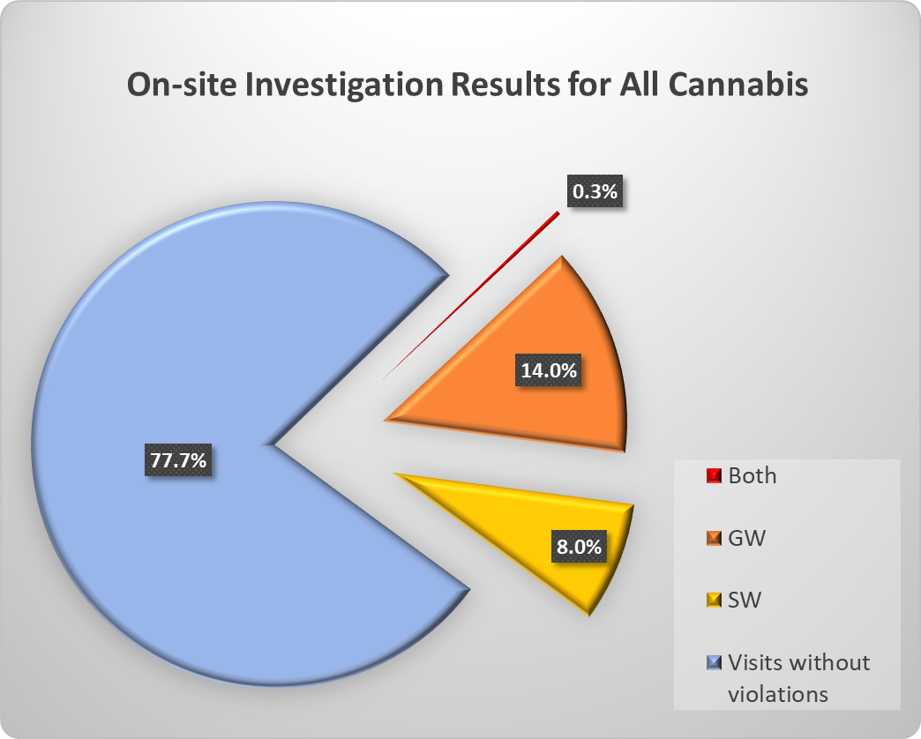
2022 On-site Investigation Results
OWRD staff performed 677 on-site investigations of cannabis showing 22% (N=677) of grow sites were found in violation of Oregon water law
Of those found in violation 54% (N=150) received formal violation notices to achieve compliance

Slide 11
2022 On-site Investigation Results*
*Data available as of October 31, 2022
Cannabis Type | On-site Investigations | Violations | Violations as Percent of Investigations | Formal Enforcment Notices Given
OLCC | 424 | 81 | 19% | 31
ODA | 125 | 10 | 8% | 3
Unregistered | 128 | 59 | 46% | 47
Total | 677 | 150 | 22% | 81

Slide 12
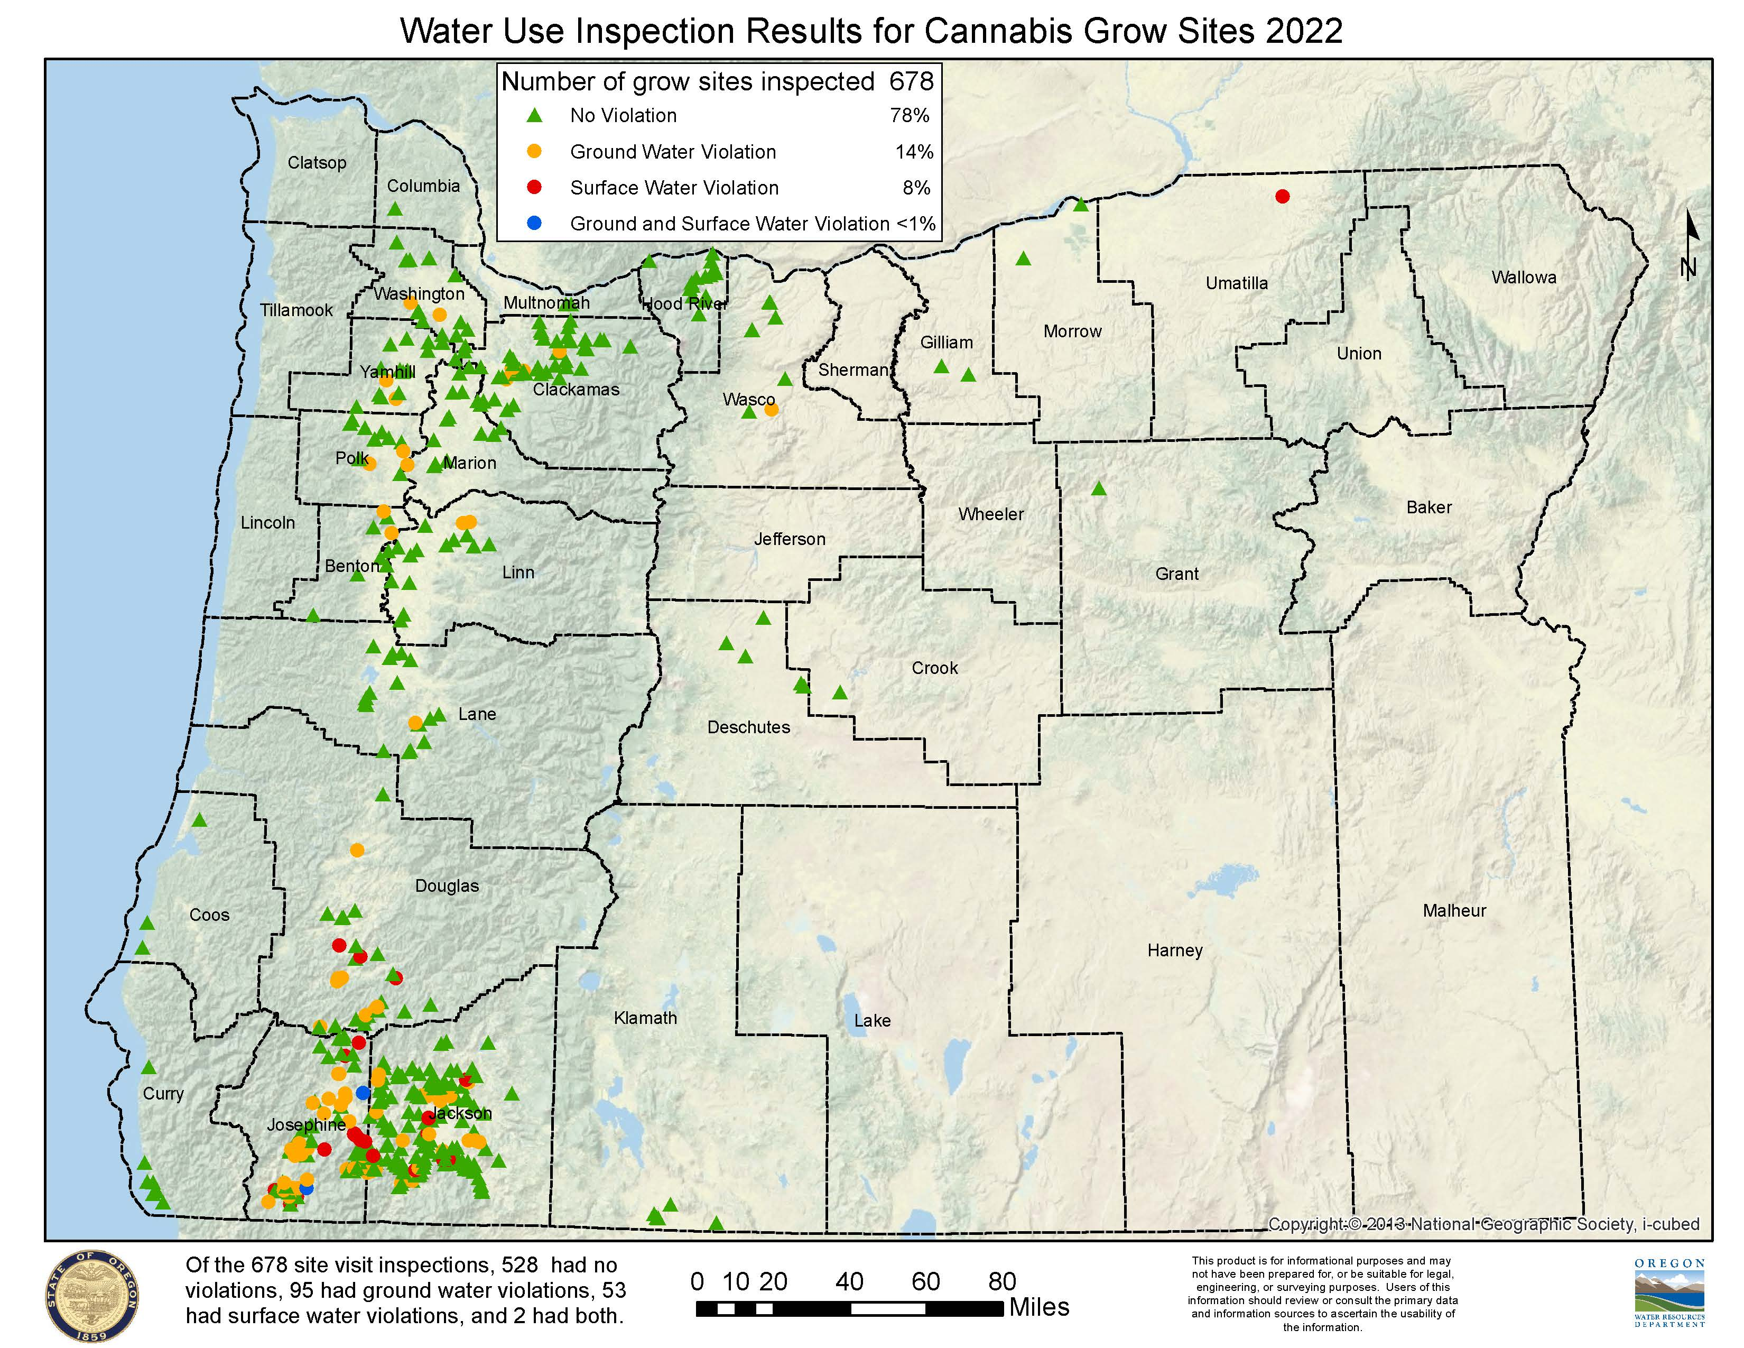

Slide 13
OLCC On-site Investigations
25% (N=1704) of known sites were investigated in person by staff.
19% (N=424) of on-site investigations found water law violations.
Formal enforcement notices were issued to 38% (N=81) of those sites with violations

Slide 14
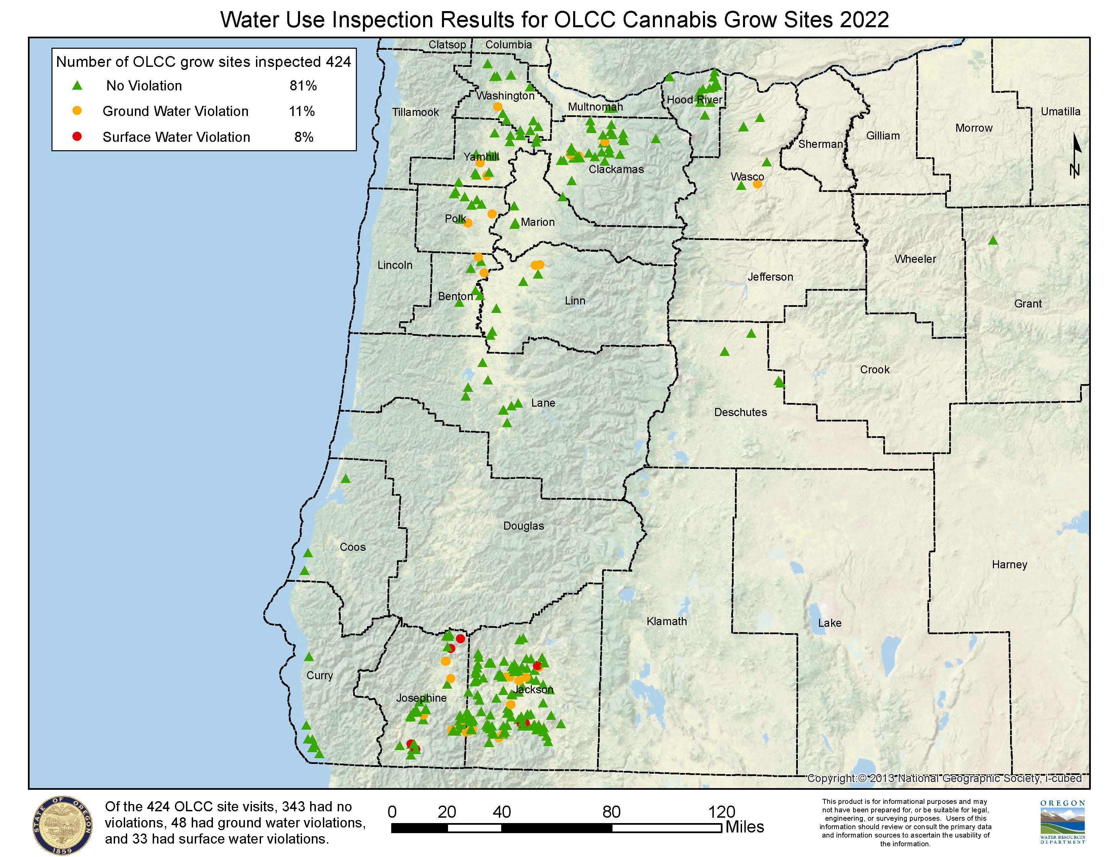

Slide 15
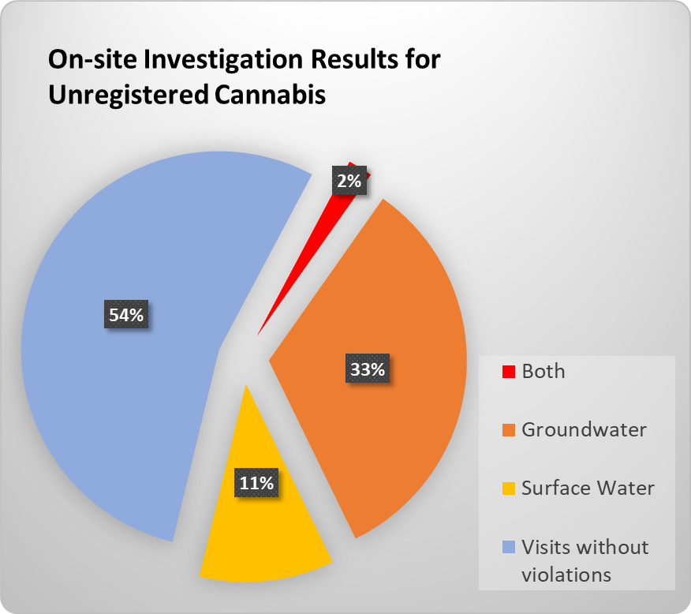
Unregistered Cannabis On-site Investigations
83% (N=155) of unregistered sites made known to OWRD in 2022 were investigated in person by department staff.
46% (N=128) of on-site investigations found water law violations.
To achieve compliance formal enforcement notices were issued to 80% (N=59) of sites found in violation.

Slide 16
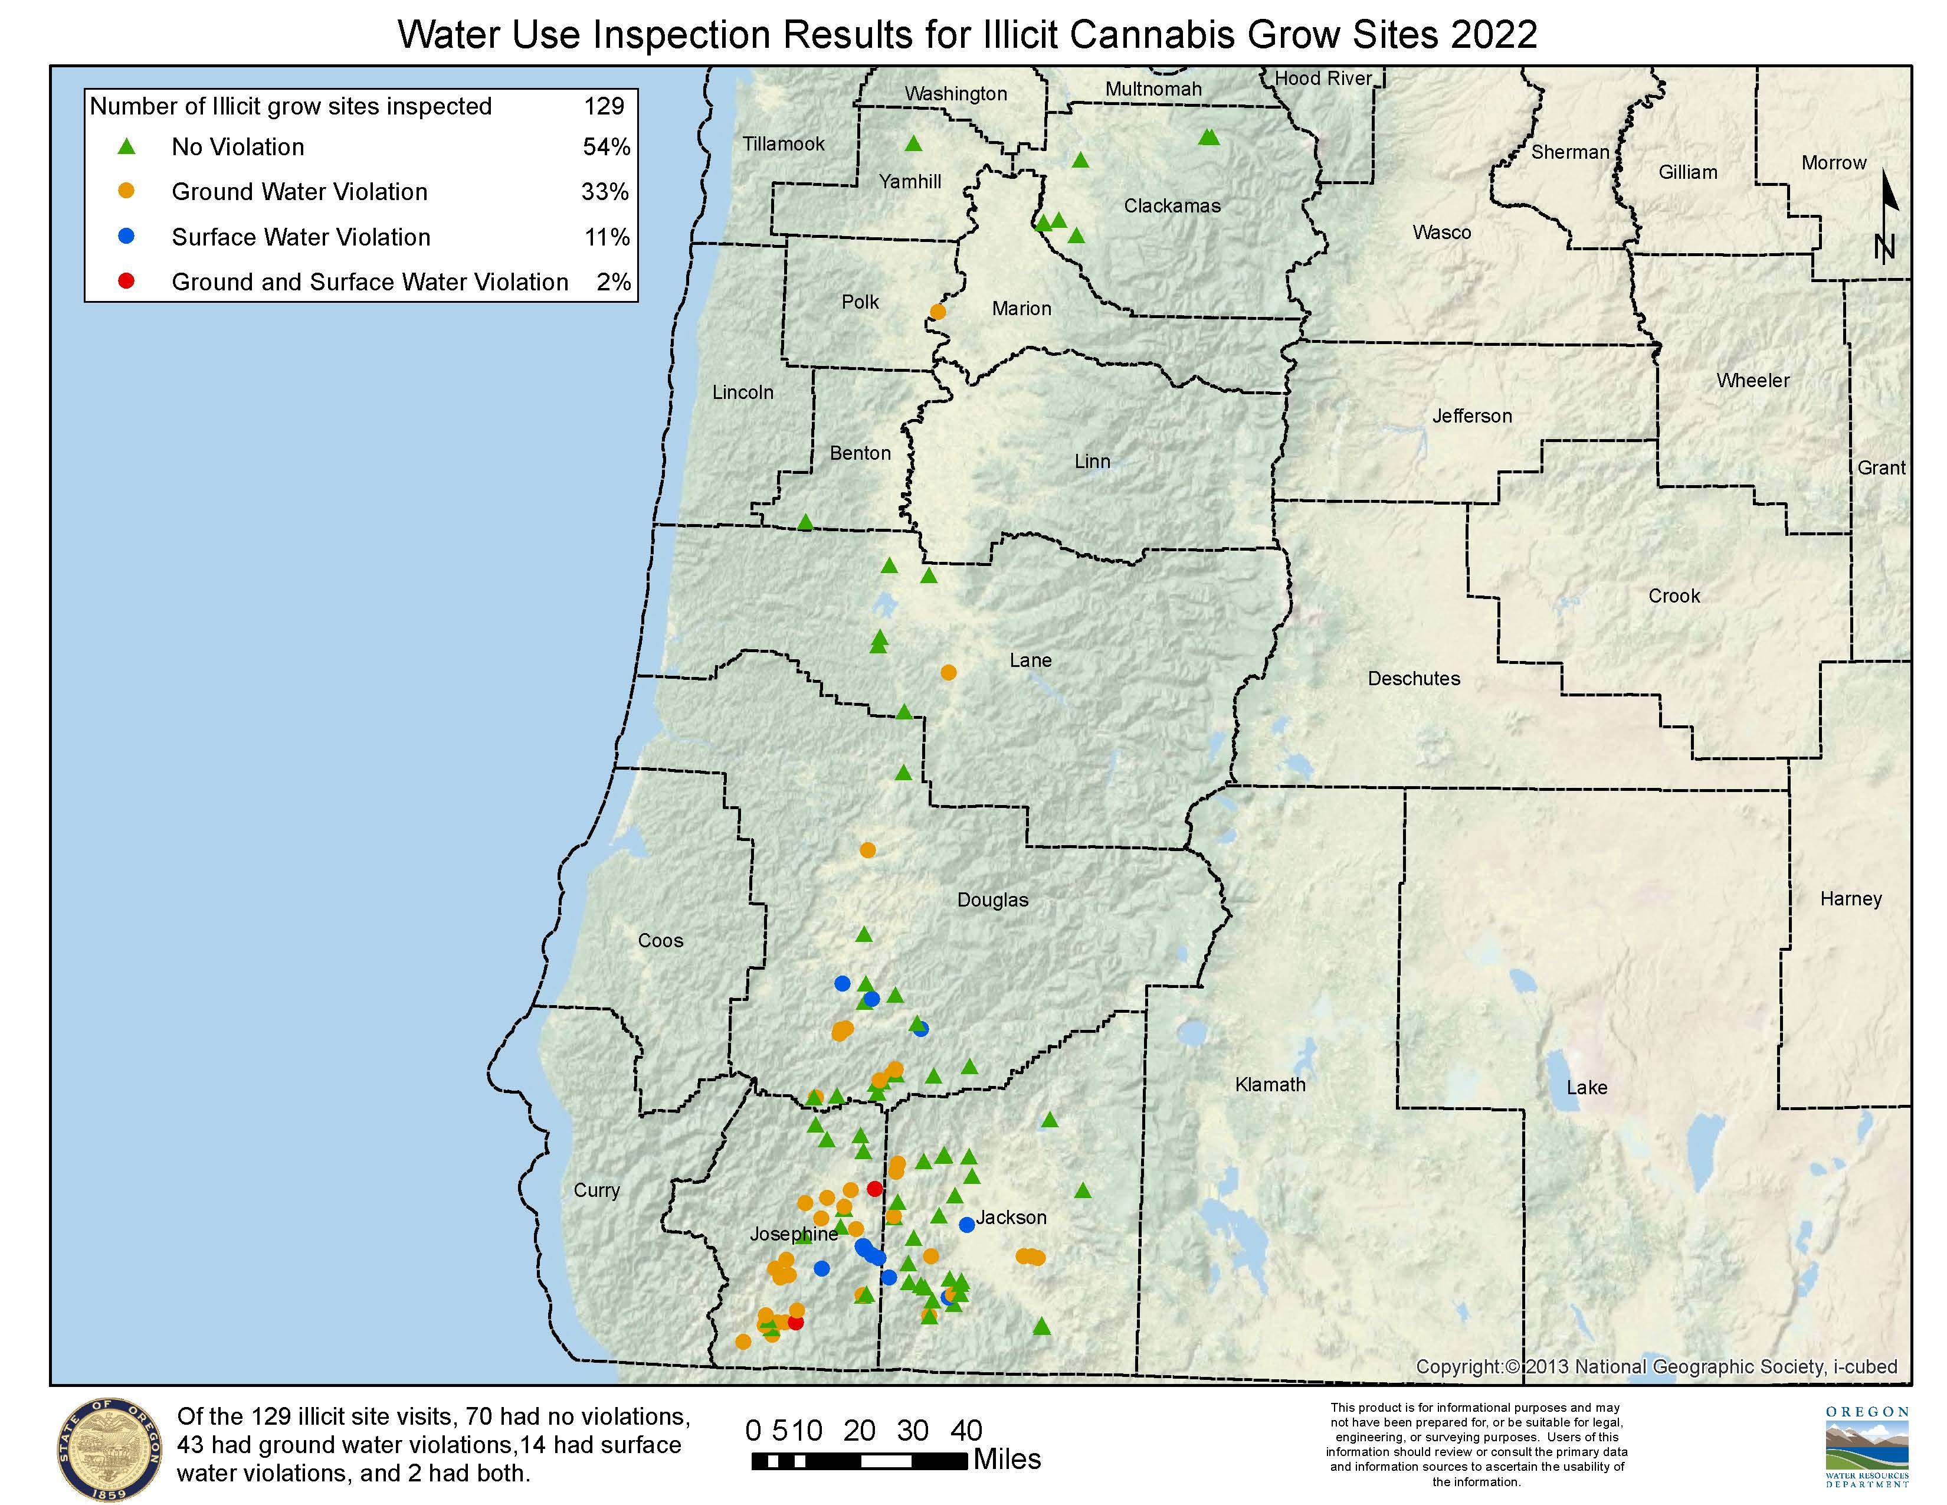

Slide 17
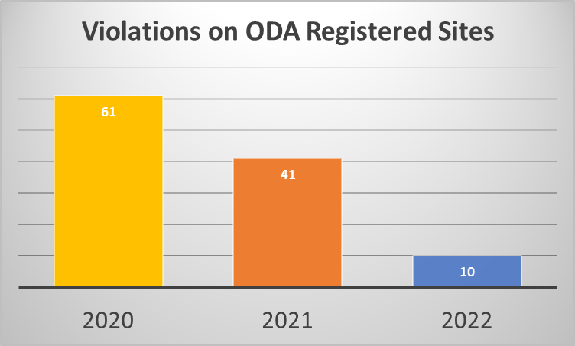
ODA Hemp On-site Findings
In 2022, 125 ODA Registered Sites were investigated in person by OWRD staff, 10 had violations making up 8% of registrants.
33%
24%
8%

Slide 18
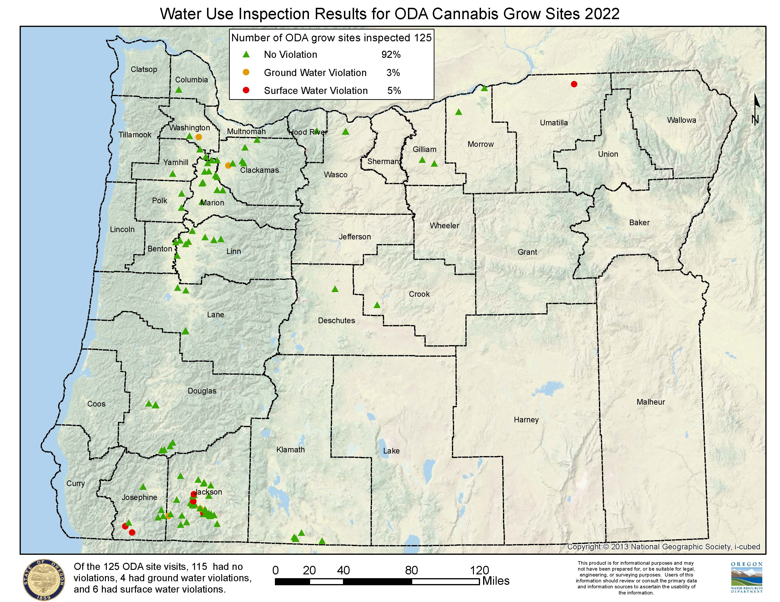

Slide 19
Inter-Agency Collaboration
Sister Agencies – DSL, DEQ, ODA, OLCC, OHA, ODFW and more
County Code Enforcement – Plan/Site Review and collaborative work on site visits
Law Enforcement – County and State Drug Teams
Notes:
OLCC and ODA provide licensee information.
Inspectors notify when they observe WR violations.
We notify those agencies when we find licensed sites in violations.
HB 3000 Taskforce – NR Sub-committee provided legislative recommendations. Initiated inter agency collaboration that continues today.
County Code – We notify them when we observe structures that may be unpermitted, and they provide information when they observe potential WR violations.
Law Enforcement – Similar information sharing. LE assists on raids with Code enforcement. Key for our access challenges.
DOJ – Environmental Crimes – our bridge with DA’s and CJC administer grants to LE and NGO’s.

Slide 20
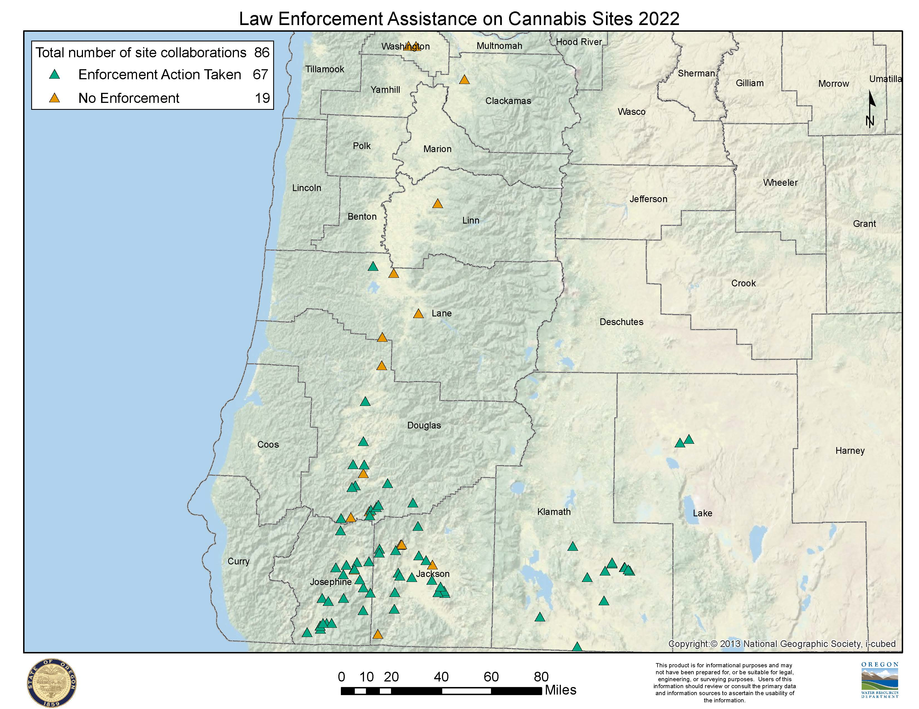

Slide 21
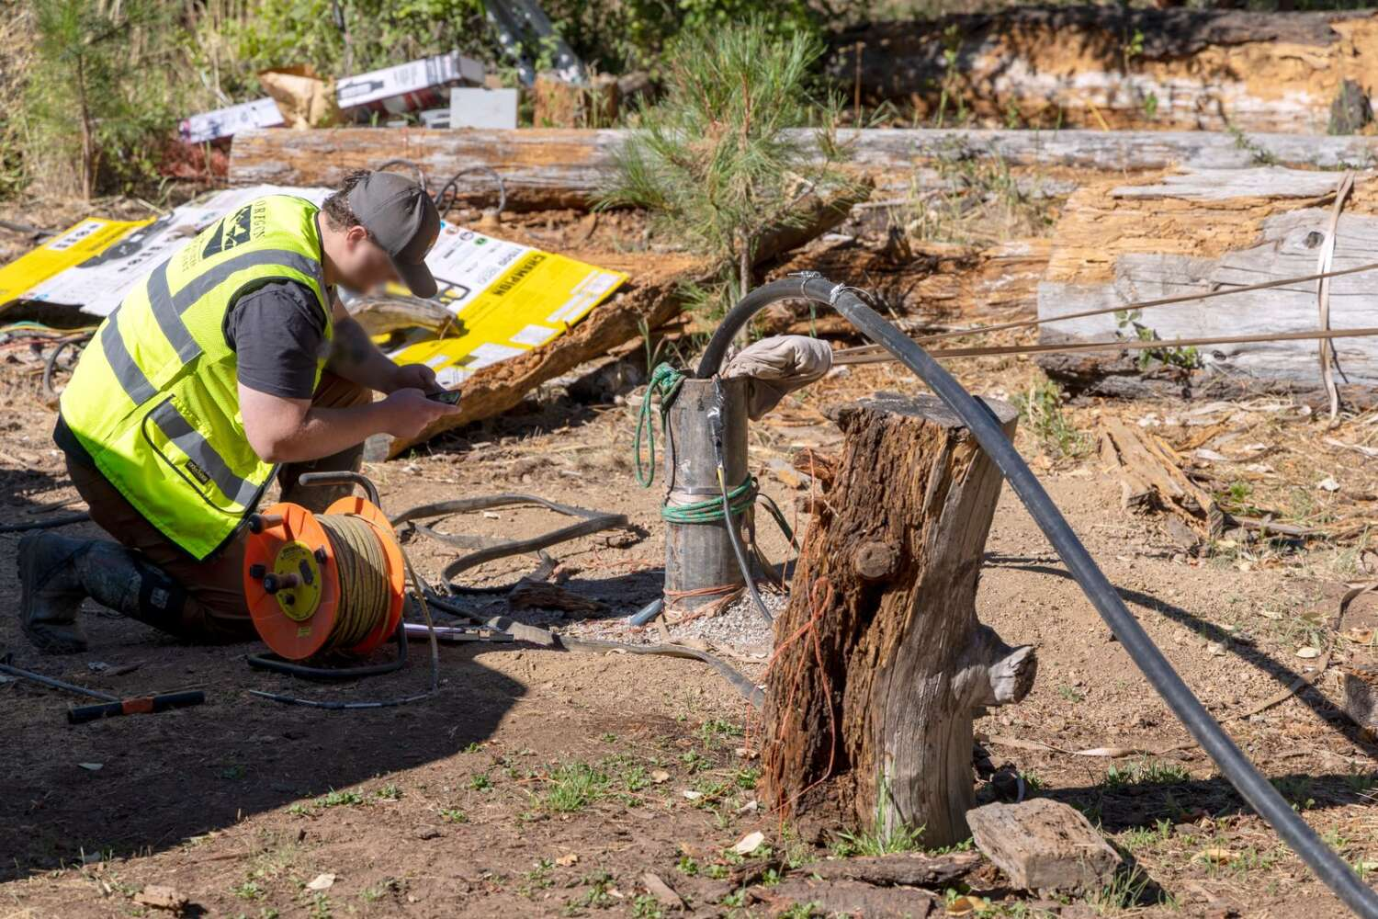
Evolution of Field Work
Boom in small farm operations
Types of complaints and complex issues
Partnership with county code and law enforcement
Absentee landowner and lease operations
Responsible party identification
Access challenges
Field safety
Volume of work
Notes:
Small Farms – Utilization of Irrigation District, water hauling and other surface and GW rights to include supplemental.
Increase in GW violations from domestic wells.
Collaboration with stakeholders – stakeholders in the field have changed – In some parts of the state we spend mote coordinating Law Enforcement and Code Enforcement than traditional stakeholders.
Absentee Landowners, leases, and shell companies as well as Unregistered operators have made it difficult to identify responsible parties.
This has resulted in Property Access challenges due to unregistered activity and access denial. This has become incredibly time consuming for staff when trying to investigate complaints.
As a secondary consequence it has resulted in changes in how we approach field site safety and hazard site assessments.
Field Safety – Unregistered activity has changed how we perform safety assessments for properties and the hazards such as solid waste and chemicals.
Volume of Work - Volume of WR researches, new communication with bulk water suppliers, partner agencies and LE

Slide 22
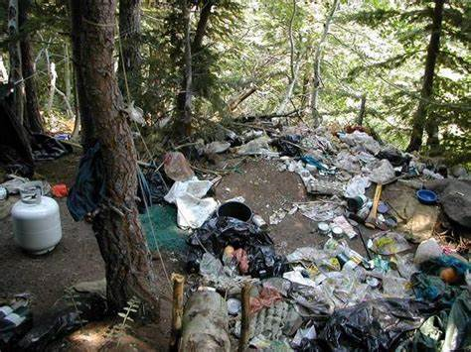
Looking Ahead
Continued collaboration with Code and Law Enforcement.
Utilization of new OWRD Enforcement Section
Expand Collaboration and Info Sharing with Natural Resource Partner Agencies
Improve Data Collection
and Analytics
Interagency Trainings
Notes:
Partnerships and collaboration with Code Enforcement and LE – Advancing that coordination as represented with some upcoming planning meetings.
Enforcement Section – Workflow improvements, increased capacity for field staff and relieving administrative burdens.
NR Partner Agencies – Continued collaboration and coordination to leverage resources and authority in addressing the environmental impacts as a whole.
Once the illegal appropriation is addressed often additional environmental damage is present.
Interagency Training
Surface and Ground Water Trainings scheduled with LE, OLCC, and ODA. This will improve information sharing and how we communicate. With cross agency training we can share information and receive notification when other agencies witness potential water law violations.
In Summary allot of great work has been done but, theirs a lot of work to do yet. Local sheriffs in the SW have asked for 10 years of sustained funding to really address unregistered grows. We have ongoing compliance checks that was need to occur, often grow operations that number in the thousands are transferred to new individuals, and much of the environmental damage still remains after the illegal appropriation is addressed on raid sites.
Finally, illegal water use continues to be of great concern to the community and whose members remain frustrated when NR agencies and LE struggle to address issues such as unregistered grows in a timely manor.

